Slide 1
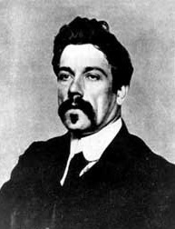
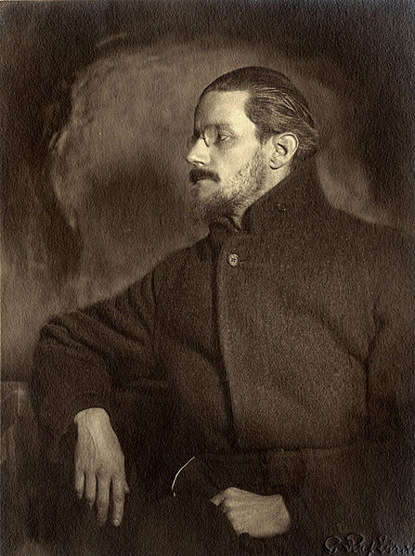
Joyce & Synge: The Exile and the Tramp
A Keynote Lecture at ABEI: A Hundred Years of Independence
28 September 2021
‘Synge is a storm centre: but I have done nothing.’ (Joyce to Stanislaus Joyce, letter of 16 Feb. 1907, in Selected Letters, ed. Richard Ellmann, London: Faber & Faber 1975, p.150.)
‘The tramper Synge is looking for you, he said, to murder you. He heard you pissed on his halldoor in Glasthule. He’s out in pampooties to murder you.’ (Buck Mulligan to Stephen, in Ulysses, 1922.)
Bruce Stewart
UFRN / UU (emeritus)

Slide 2
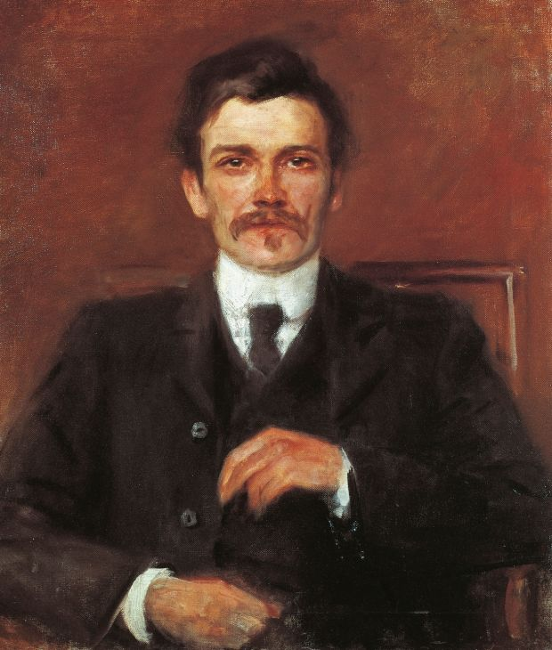
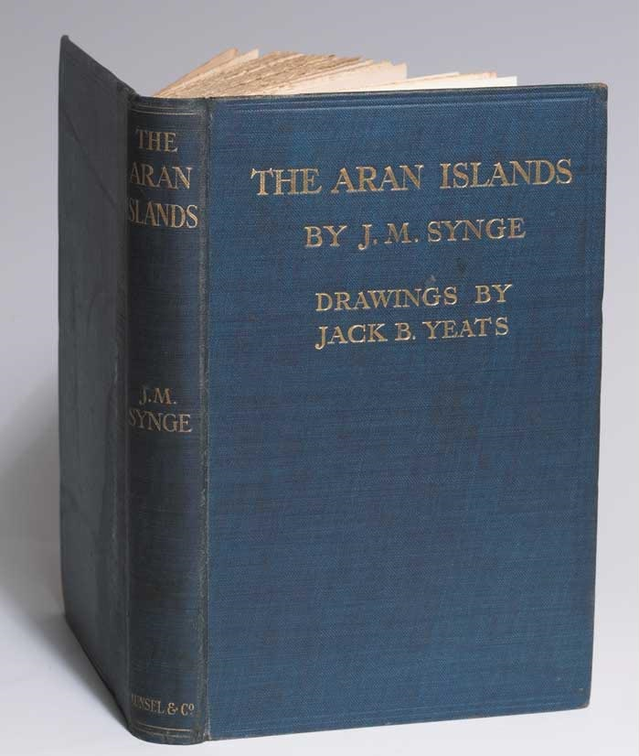
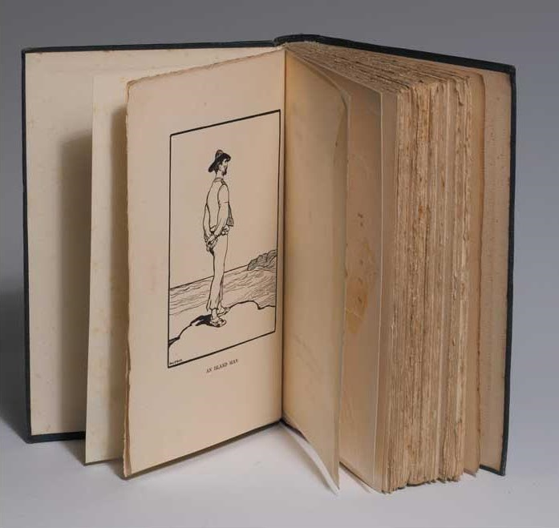
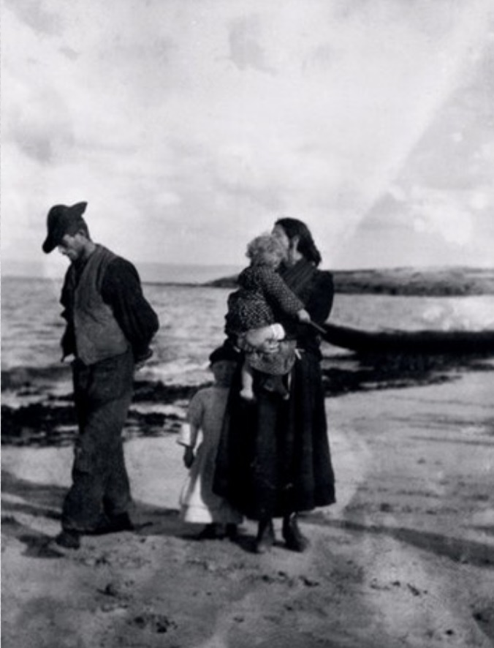
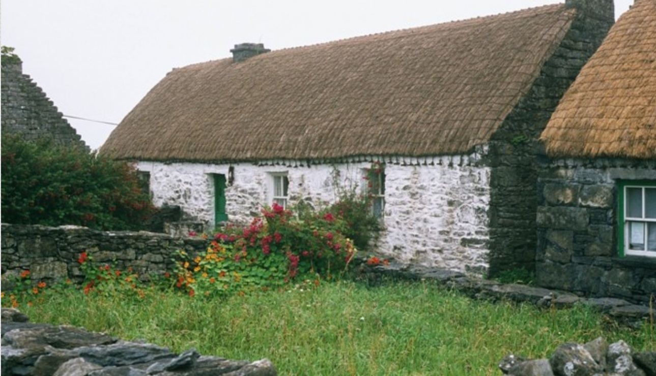

The journey westward
Synge’s Aran Islands (1907 based on his time there – where he also took photos with a Kilto camera.
W. B. Yeats ( ‘Bounty of Sweden’), ‘I had met John Synge in Paris in 1896. Somebody had said, “There is an Irishman living on the top floor of your hotel; I will introduce you.’ I was very poor, but he was much poorer. He belonged to a very old Irish family and, though a simple courteous man, remembered it and was haughty and lonely with just enough to keep him from starvation [...] he had wandered about Europe, travelling third-class or upon foot, playing his fiddle to poor men on the road or in their cottages. He was the man that we needed, because he was the only man I have ever known incapable of a political thought or a humanitarian purpose. He could walk the roads all day with some poor man without any desire to do him good or for any reason except that he liked him. [...] I did not, however, see what was to come when I advised John Synge to [567] go to a wild island off the Galway coast and study its life because that life “had never been expressed in literature”. He had learned Gaelic at College and I told him that, as I would have told it to any young man who had learned Gaelic and wanted to write. When he found that wild island he became happy for the first time, escaping, as he said “from the nullity of the rich and the squalor of the poor”. He had bad health, he could not stand the island hardship long, but he would go to and fro between there and Dublin.’ (Autobiographies, pp.567-78.)

Slide 3
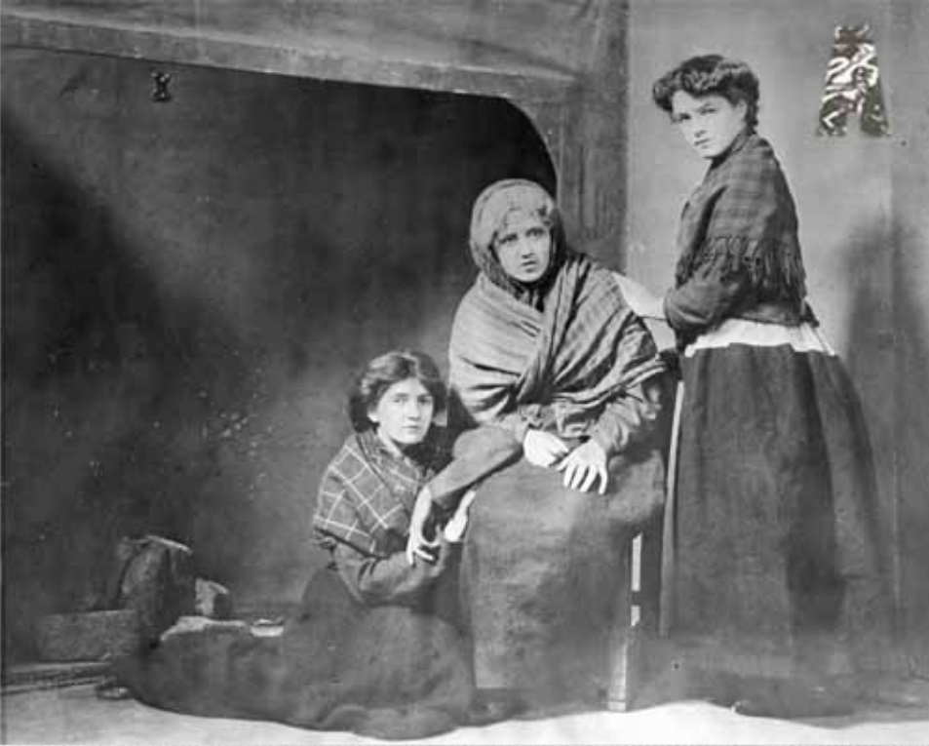
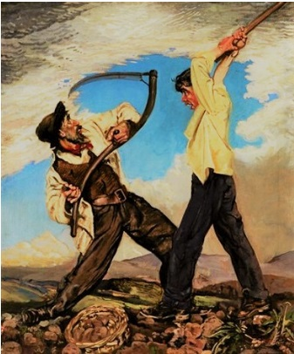
Riders to the Sea (1904)
NORA (in a whisper to CATHLEEN). She’s quiet now and easy; but the day Michael was drowned you could hear her crying out from this to the spring well. It’s fonder she was of Michael, and would any one have thought that?
CATHLEEN (slowly and clearly). An old woman will be soon tired with anything she will do, and isn’t it nine days herself is after crying and keening, and making great sorrow in the house?
MAURYA (puts the empty cup mouth downwards on the table, and lays her hands together on Bartley’s feet). They’re all together this time, and the end is come. May the Almighty God have mercy on Bartley’s soul, and on Michael’s soul, and on the souls of Sheamus and Patch, and Stephen and Shawn (bending her head); and may He have mercy on my soul.
NORA, and on the soul of every one is left living in the world. (She pauses, and the keen rises a little more loudly from the women, then sinks away.)
MAURYA (continuing). Michael has a clean burial in the far north, by the grace of the Almighty God. Bartley will have a fine coffin out of the white boards, and a deep grave surely. What more can we want than that? No man at all can be living for ever, and we must be satisfied. (She kneels down again and the curtain fails slowly.)
The Playboy (1907)
CHRISTY: It’s little you’ll think if my love’s a poacher’s, or an earl’s itself, when you’ll feel my two hands stretched around you, and I squeezing kisses on your puckered lips, till I’d feel a kind of pity for the Lord God is all ages sitting lonesome in His golden chair.’
PEGEEN: ‘That’ll be right fun, Christy Mahon, and any girl would walk her heart out before she’d meet a young man was your like for eloquence, or talk at all.’
CHRISTY (encouraged): ‘Let you wait, to hear me talking, till we’re astray in Erris, when Good Friday’s by, drinking a sup from a well, and making mighty kisses with our wetted mouths, or gaming in a gap of sunshine, with yourself stretched back unto your necklace, in the flowers of the earth.’
PEGEEN (in a low voice, moved by his tone): ‘I’d be nice so, is it?’
CHRISTY (with rapture): ‘If the mitred bishops seen you that time, they’d be the like of the holy prophets, I’m thinking, do be straining the bars of paradise to lay eyes on the Lady Helen of Troy, and she abroad, pacing back and forward, with a nosegay in her golden shawl.’
PEGEEN (with real tenderness): ‘And what is it I have, Christy Mahon, to make me fitting entertainment for the like of you, that has such poet’s talking, and such bravery of heart.’
CHRISTY: (in a low voice): ‘Isn’t there the light of seven heavens in your heart alone, the way you’ll be an angel’s lamp to me from this out, and I abroad in the darkness, spearing salmons in the Owen or the Carrowmore?

Slide 4
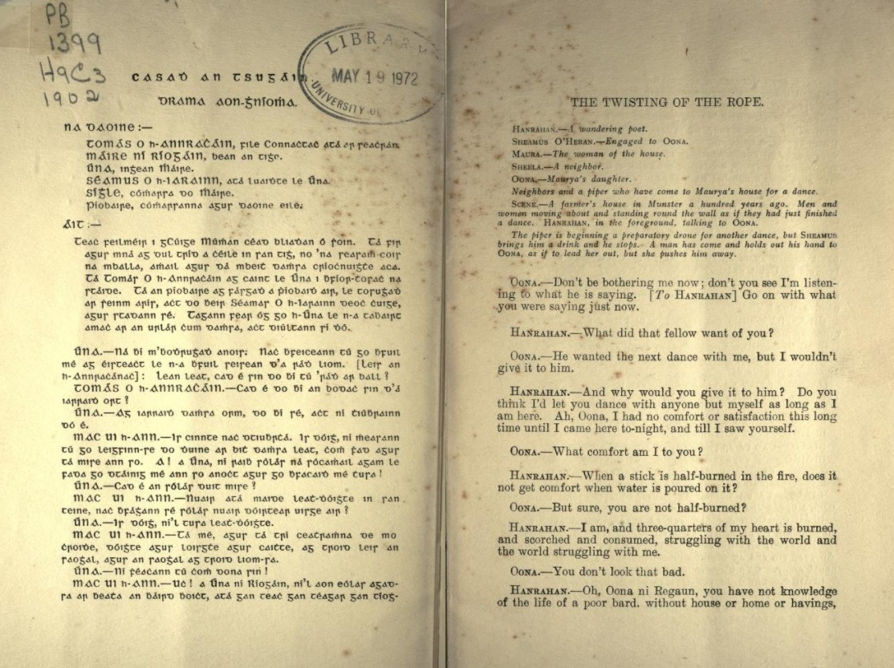
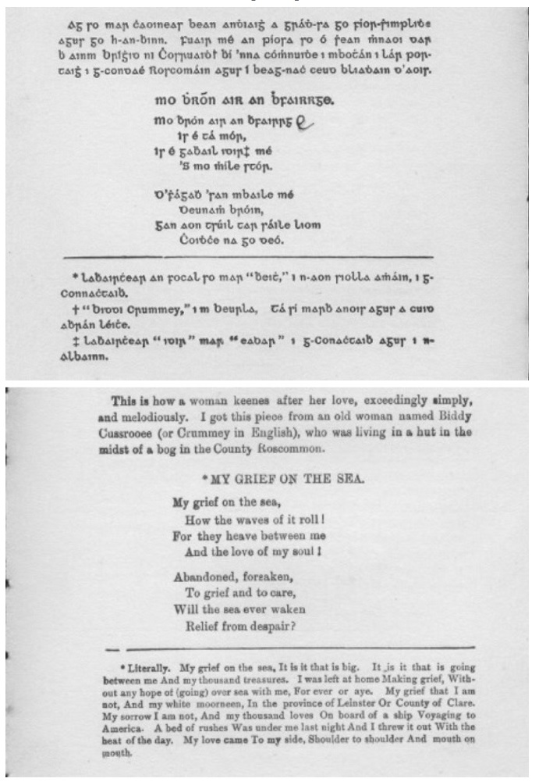
Douglas Hyde and the inter-language of the Irish Literary Revival
Abhráin Grádh Chúige Connacht, or Love Songs of Connacht [3rd edn.] (London: T. Fisher Unwin 1893)
Casadh an tSúgáin, bilingual edition with a translation by Lady Gregory (Dublin: An cló-cumann 1902)

Slide 5
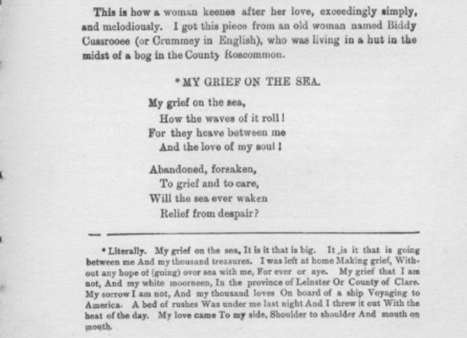
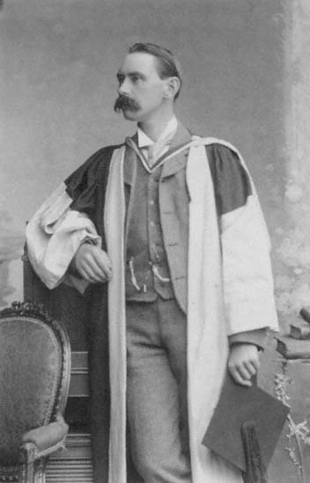
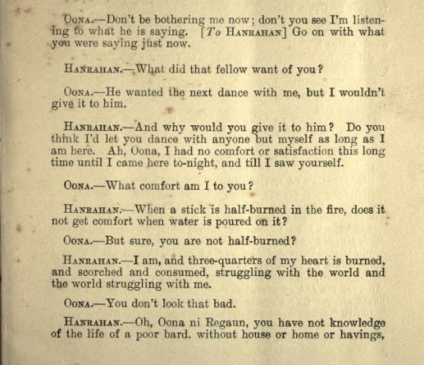
Hiberno-English translations by Hyde and Lady Gregory
H: And why would you not give it to him? Do you think I’d let you dance with anyone but myself as long as I am here. Ah, Oona, I had no comfort or satisfaction this long time until I came here to-night, and till I saw yourself.
O: What comfort am I too you?
H: When a stick is half-burned in the fire, does it not get comfort whe water is poured on it?
O: But, sure, you are not half-burned?
H: I am, and three-quarters of my heart is burned, and scorched and consumed, struggling with the world and the world struggling with me.
Douglas Hyde (1860-1949)
Literally. My grief on the sea. It is that big. It is it that is going between me And my thousand treasures. I was left at home Making grief, Without any hope of going over sea with me, for ever or aye. My grief that I am not, And my white moorneen, In the province of Leinster Or County of Clare. My sorrow I am not, And my thousand loves On board of a ship Voyaging to America. A bed of rushes was under me last night And I threw it out With the heat of the day. My love came To my side, Shoulder to shoulder And mouth to mouth.

Slide 6
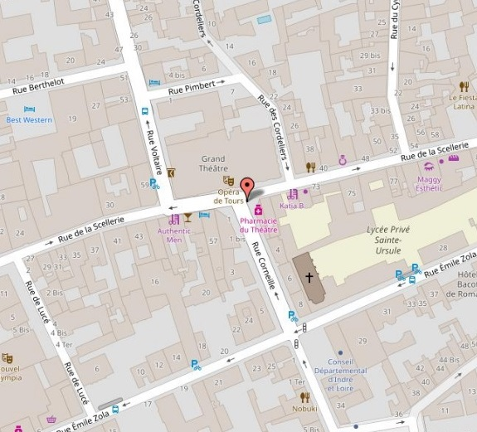
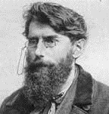
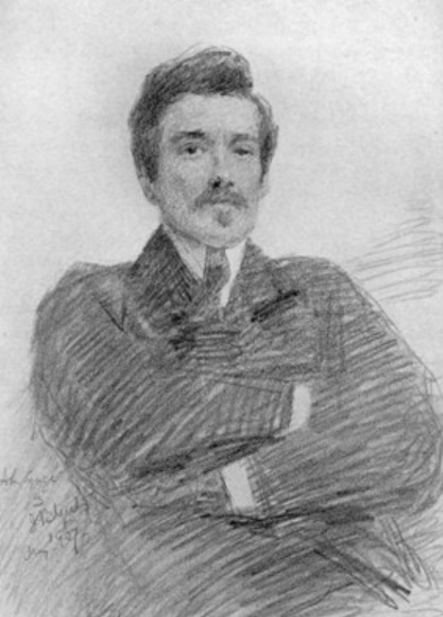
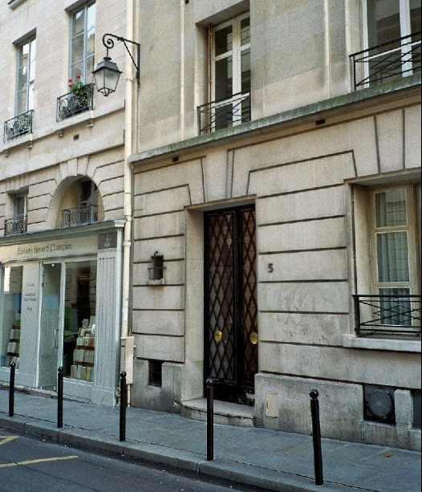
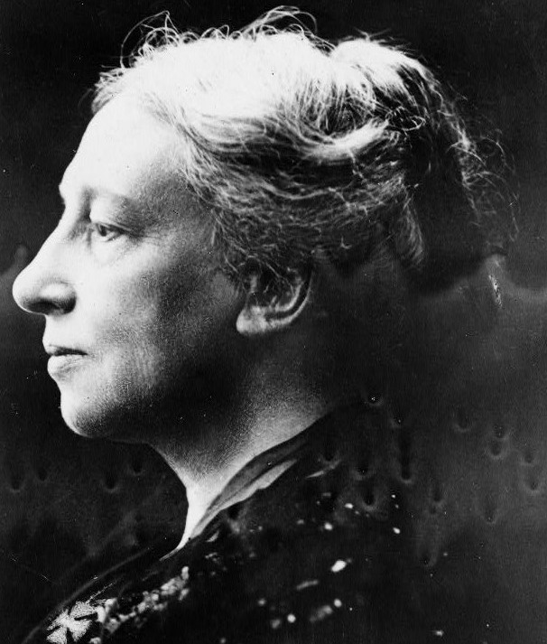
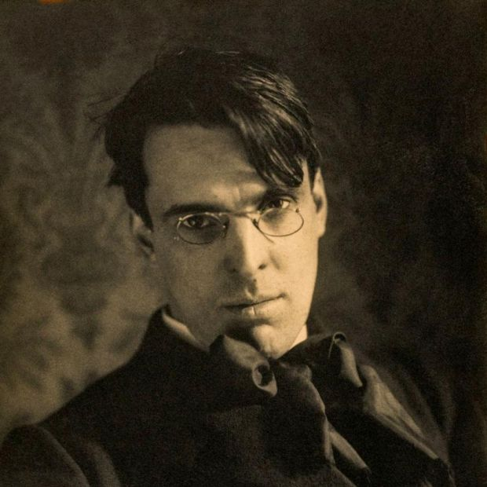
Welcome, O life ...
Grand Hotel Corneille – at 5 rue Corneille, Paris, 6º arr. Synge had lived in chiefly Paris since 1896 but was leaving for Dublin in 1903.
Joyce reached Paris on 2. Dec 1903, returned to Dublin for Christmas and went back to Paris in January 27th. He met Synge at the Hotel Corneille on March 6th 1903.
Stephen’s paean to ‘Life’ at the close of A Portrait of the Artist as a Young Man [1916] (London: Cape 1968), p.257.
[...]
April 26. Mother is putting my new secondhand clothes in order. She prays now, she says, that I may learn in my own life and away from home and friends what the heart is and what it feels. Amen. So be it. Welcome, O life, I go to encounter for the millionth time the reality of experience and to forge in the smithy of my soul the uncreated conscience of my race.
April 27. Old father, old artificer, stand me now and ever in good stead.
Dublin, 1904
Trieste, 1914

Slide 7
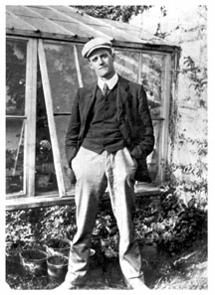
Meeting the Ango-Irish
Joyce to Lady Gregory (Nov. 1902): ‘[...] I know there is no heresy or no philosophy which is so abhorrent to my church as a human being, and accordingly I am going to Paris. [...] I do not know what will happen to me in Paris but my case can hardly be worse than it is here. [...] I am not despondent however for I know that even if I fail to make my way such failure proves very little. I shall try myself against the powers of the world. All things are inconstant except the faith in the soul, which changes all things and fills their inconstancy with light. And though I seem to have been driven out of my country here as a misbeliever I have found no man yet with a faith like mine.’ (Typescript copy made by Lady Gregory, held among the papers of W. B. Yeats, with an inscription on verso in WBY’s hand; Letters, ed. Stuart Gilbert, Vol. I [1957], 1966, p.53; Selected Letters, ed. Richard Ellmann, London: Faber & Faber 1975, p.8.)*
Lady Gregory (letter to W. B. Yeats, then in London): ‘I wonder if Joyce has written to you? Poor boy, I am afraid he will knock his ribs against the earth, but he has grit and will succeed in the end. You should write and ask him to breakfast with you on the morning he arrives, if you can get up early enough, and feed him and take care of him and give him dinner at Victoria before he goes, and help him on his way. I am writing to various people who might possibly get him tuitions, and to Synge who could at least tell him of cheap lodgings.’ (Quoted in Elizabeth Coxhead, Lady Gregory, London, Secker & Warburg 1966, p.124; also cited in Ann Saddlemyer, op. cit., 1982, p.209 [n. 27].)
Lady Gregory (letter to J. M. Synge, then in Paris]: ‘Poor Joyce! The funny thing is that Longworth of the Express whom I had asked for work for Joyce has sent him my Poets & Dreamers to review, as a kindness to us both! I wonder what the review will be like!’ (Letter of 29 March; in Theatre Business, ed. Ann Saddlemyer, Gerrards Cross, Colin Smythe, 1982, p.38; quoted in Saddlemyer, op. cit. 1982, p.209 [n.31].)
*The letter was found in a typescript among Yeats papers. (Ellmann, Sel. Letters, 1975, p.8. n.1.) This almost certainly means that Lady Gregory typed it and sent it to him by way of informing him about Joyce’s progress. That fact can only deepen our sense that Joyce was now in the network of epistolary relations which characterised the dominant group in the Revival – and this, in turn, conditioned his ‘Aristotelian’ reaction to Synge’s play considered as a ‘push=back’ against the leaders.
JM Synge to Lady Gregory (on Joyce): ‘He seems to be pretty badly off, and is wandering about Paris rather unbrushed and rather indolent, spending his studious moments in the National Library reading Ben Jonson. French literature I understand is beneath him! Still he interested me a good deal and as he is being gradually won over by the charm of French life his time in Paris is not wasted. He talks of coming back to Dublin in the summer to live there on journalism while he does his serious work at his leisure. I cannot think that he will ever be a poet of importance, but his intellect is extraordinarily keen and if he keeps fairly sane he ought to do excellent essay-writing.’ (Theatre Business, ed. Saddlemyer (Gerrards Cross: Colin Smythe), 1982, p.36.

Slide 8
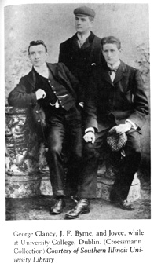
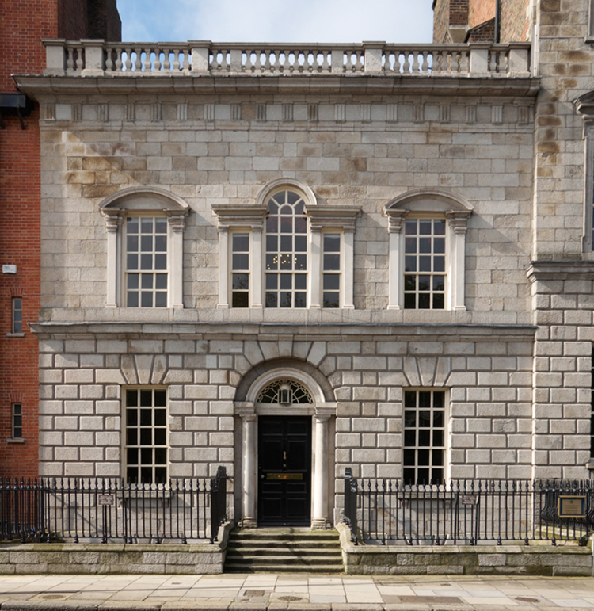
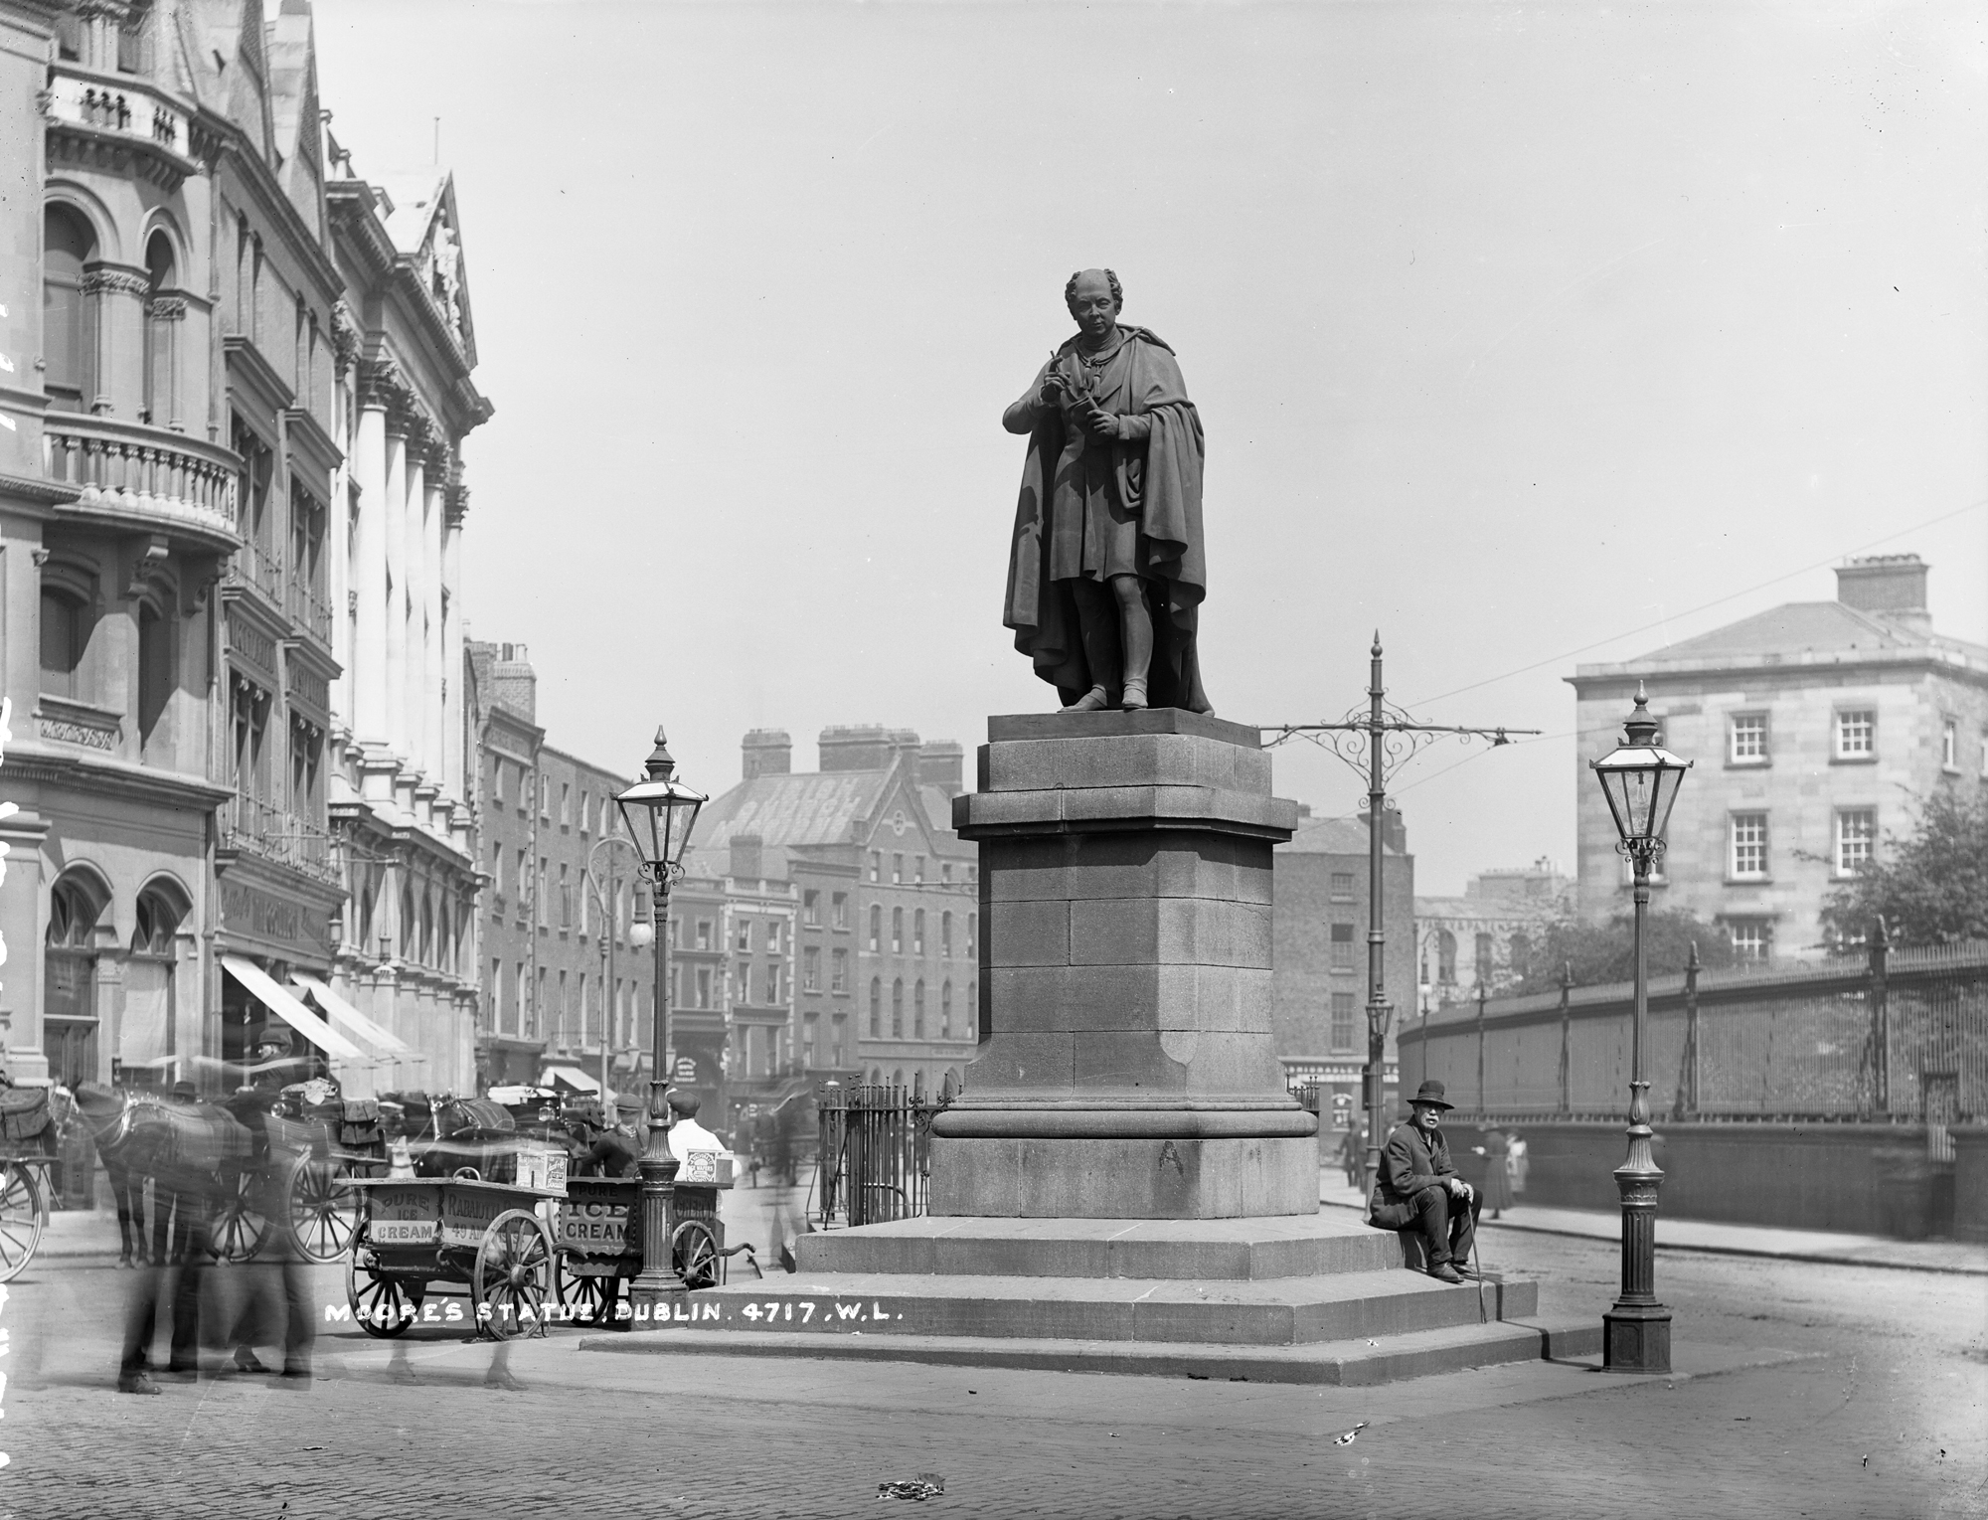
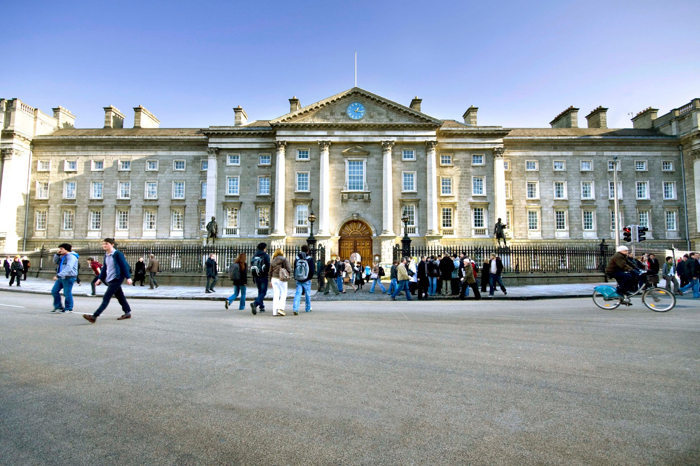
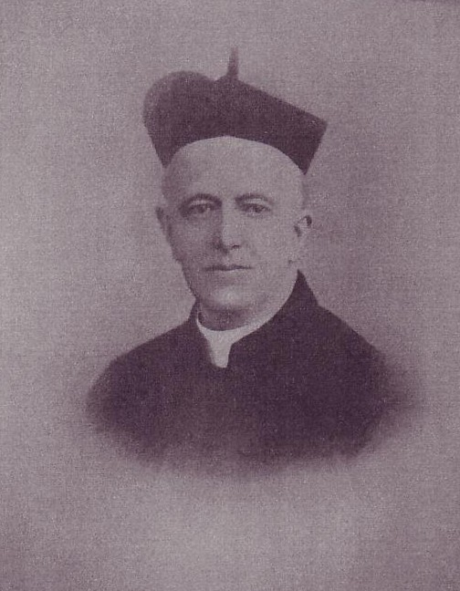
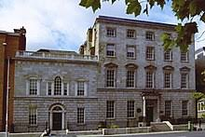
Thomas Moore
FR John Conmee SJ
University College, Dublin
Trinity College, Dublin
The cultural location of the Irish Catholic intellectual .. Joyce-style
[...] It wounded him to think that he would never be but a shy guest at the feast of the world’s culture and that the monkish learning, in terms of which he was striving to forge out an esthetic philosophy, was held no higher by the age he lived in than the subtle and curious jargons of heraldry and falconry.
The grey block of Trinity on his left, set heavily in the city’s ignorance like a dull stone set in a cumbrous ring, pulled his mind downward and while he was striving this way and that to free his feet from the fetters of the reformed conscience he came upon the droll statue of the national poet of Ireland.(Portrait, Ch. 5.)
Graduate class, University College Dublin [UCD] 1902. George Clancy [on the left] was shot by Black and Tans when mayor Limerick in the War of Independence. For Joyce he was the ‘peasant student’ ... J. F (“Jeff”) Byrne is the Cranly of A Portrait.

Slide 9
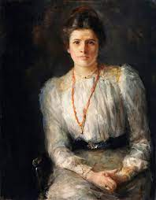
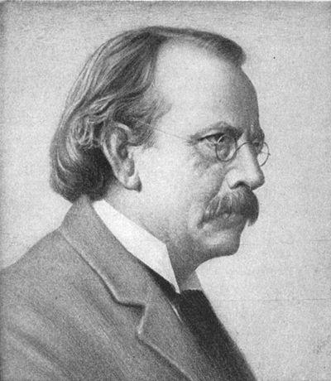
Dubliners and the ‘well-bred’ reader
Lily Yeats on Dubliners: ‘[O]f their lives I knew nothing, what went on behind the dirty windows, windows like those behind which James Stephens’s charwomen lived, which were so dirty anyone wishing to look out had to open them. Since I read Dubliners I feel I know something of their lives.’
(Letter to John Quinn, 1 June 1917).
J. M. Hone on Dubliners: Mr. Joyce’s books exhibit a type of young Irishman of the towns - mostly originating from the semi-anglicised farming or shopkeeping class of the cast and centre - a type which has been created largely by the modern legislation which provides Catholic democracy in Ireland with opportunities for an inexpensive university education.
As social documents, therefore, Mr. Joyce’s novels and stories are much more important than Synge’s plays and stories; for the later writer describes, intimately and realistically, a growing Ireland, not, as Synge did, an Ireland that is passing away with the Gaelic communities of Aran and Connemara. He writes of a side of life in which - ugly though his picture may be - there is the greatest spiritual energy, a side of Irish life of which our “Protestant” novelists, like Mr. Ervine and Mr. Birmingham, scarcely wot of except in its political manifestations. […]
When I first read Portrait of the Artist as a Young Man it seemed to me that the book announced the passing of that literary Ireland in which everyone was well bred except a few politicians.
(London Mercury, January 1923, pp.306-08; in Deming, ed., James Joyce: The Critical Heritage, 1970 [Vol. 1], pp.297-99.)

Slide 10
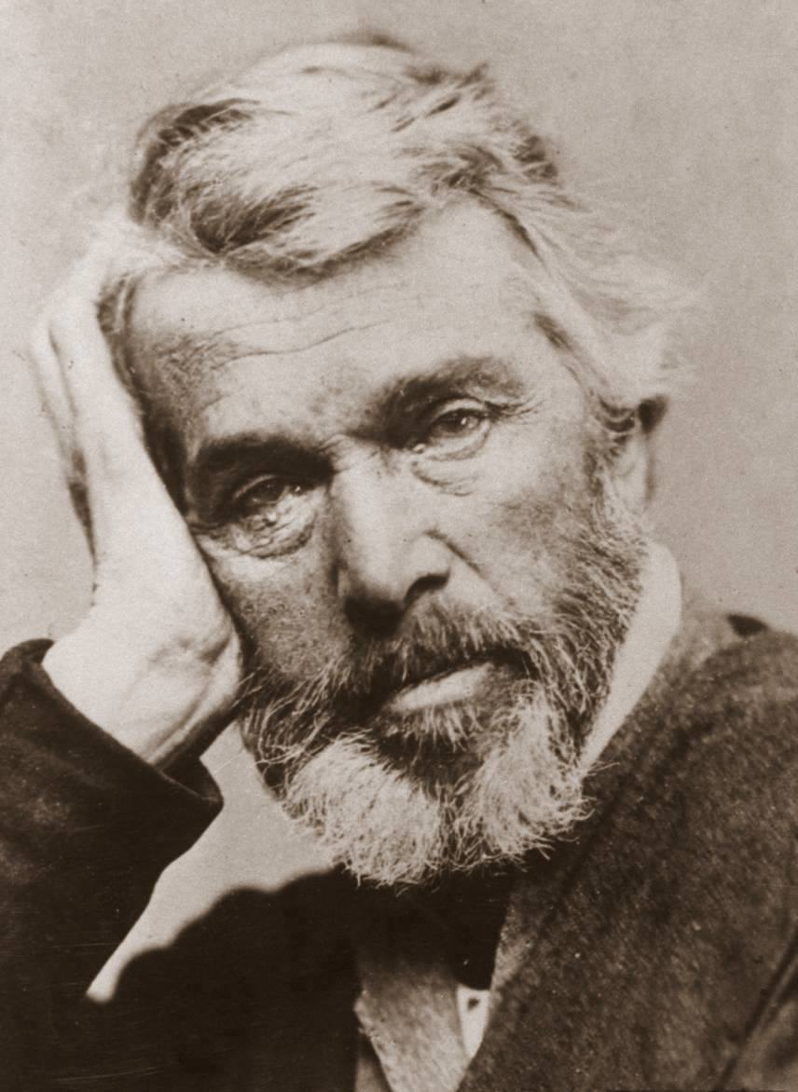
Joyce as Man of Letters – Egoism in Stephen Hero
It was part of that ineradicable egoism that he was afterwards to call his redeemer that he conceived converging to him all the deeds and thoughts of the microcosm. (Stephen Hero [1944] London: Jonathan Cape 1966, p.39.)
His family expected that he would at once follow the path of remunerative respectability and save the situation but he could not satisfy his family. He thanked their intention: it had first fulfilled him with egoism; and he rejoiced that his life had been so self-centred. (Ibid., p.53.)
Thomas Carlyle
The poet is the intense centre of the life of his age to which he stands in a relation than which none can be more vital. He alone is capable of absorbing in himself the life that surrounds him and of flinging it abroad again amid planetary music. (Ibid., p.85.)
Spiritual Paralysis: [W]henever he encountered a burly black-vested priest taking a stroll of pleasant inspection through these warrens full of swarming and cringing believers he cursed the farce of Irish Catholicism: an island the inhabitants of which entrusted their wills and mind to other that they might ensure for themselves a life of spiritual paralysis, an island in which all the power and riches are in the keeping of those whose kingdom is not of this world, an island in which Caesar confesses Christ and Christ confesses Caesar that together they may wax fat upon a starveling rabblement which is bidden ironically to take to itself this consolation in hardship ‘The Kingdom of God is within you’. (Ibid., p.151.)

Slide 11
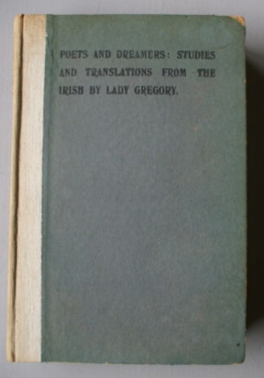
Joyce’s review of Lady Gregory’s Poets and Dreamers (1902) in the Daily Express (26 March 1903).
Lady Gregory has truly set forth the old age of her country. In her new work she has left legends and heroic youth far behind, and has explored in a land almost fabulous in its sorrow and senility. [...] These stories appeal to some feeling which is certainly not the feeling of wonder which is the beginning of all speculation. The story-tellers are old, and their imagination is not the imagination of childhood.
Joyce, ‘The Soul of Ireland’, review of Lady Gregory’s Poets and Dreamers [1903], in Daily Express (26 March 1903); rep. in Critical Writings (NY: Viking Press 1957), pp.103-04.
Buck Mulligan: ‘Longworth is awfully sick, he said, after what you wrote about that old hake Gregory. O you inquisitional drunken jew jesuit! She gets you a job on the paper and then you go and slate her drivel to Jaysus. Couldn’t you do the Yeats touch?’
Ulysses [1921] (London: Bodley Head 1960), pp.277-78.

Slide 12
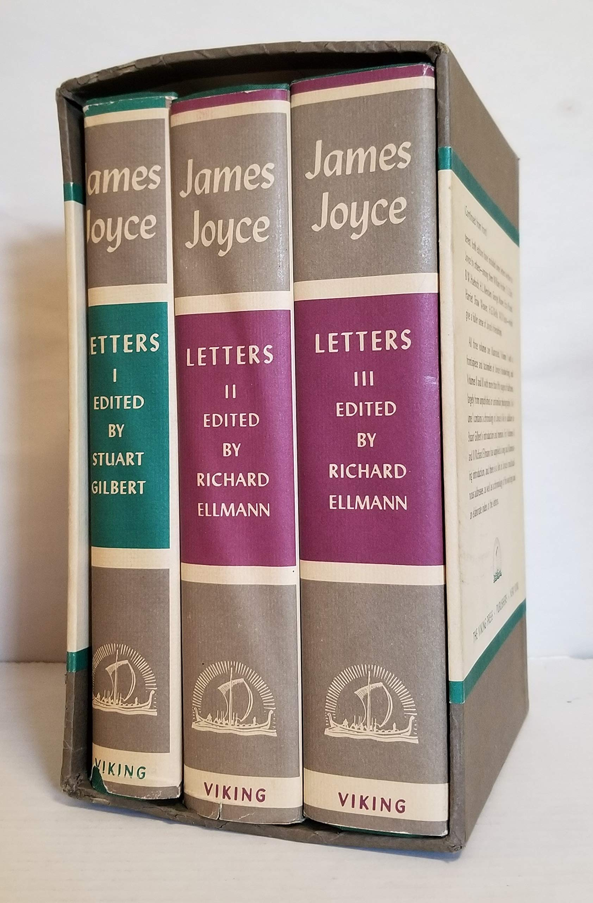
Meeting Synge - c. March 3rd 1902
To Stanislaus Joyce (9 March 1903) ‘[...] Synge is here for a few selling out – he can’t get on either and is going back to Ireland. He says the “Speaker” is always slow but once you get proof the article is sure to appear. He has written four plays - one of which is Riders to the Sea. Arthur Symons and W. B Yeats admire very much – Yeats told me it was quite Greek: I suppose Synge will be boomed now by the Irish Theatre – the plays are all in one act. Synge gave me the MS of Riders to the Sea and I have read it: it is a play of Aran in peasant dialect. I am glad to say that ever since I read it I have been riddling it mentally till it has [not] a sound spot. It is tragic about all the men that are drowned in the islands: but thanks be to God Synge is not an Aristotelian. I told him part of my esthetic: he said I have a mind like Spinosa. I cannot write a long letter as I am running for the post. [...]’
Selected Letters, 1975, p.17 [my italics]
To Harriet Shaw Weaver (8 Nov. 1916) ‘[...] I refused to sign the letter of protest against Countess Cathleen when I was an undergraduate. I was the only student who refused his signature. Some years later I made the acquaintance of Mr. Yeats. He invited me to write a play for his theatre and I promised to do so in ten years. I met Synge in Paris in 1902 (where I went to study medicine). He gave me Riders to the Sea to read and after his death I translated it into Italian. I also translated the first version and Mr. Yeats did not wish that version to be offered to the Italian publisher.’
(Sel. Letters, 1975, p.223.)

Slide 13
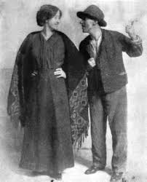
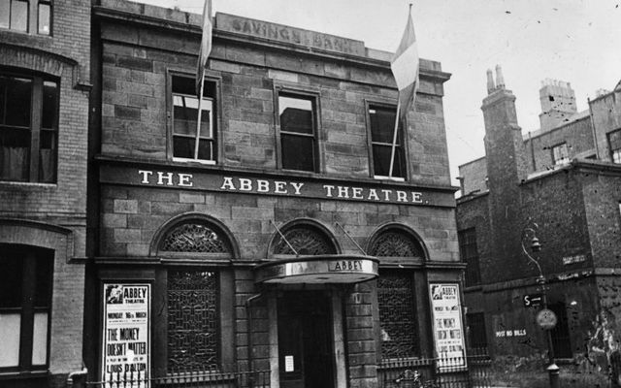
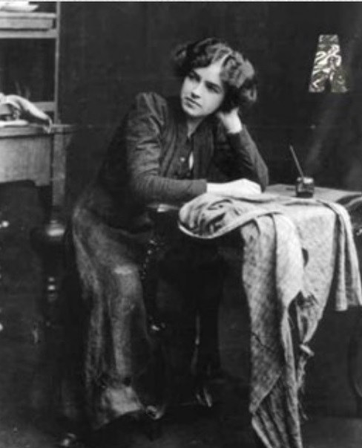
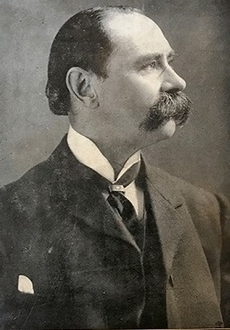
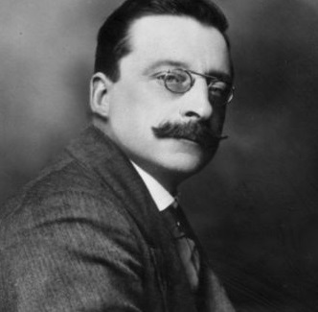
The Playboy Riot 26th January, 1907
Douglas Hyde, “The Necessity for De-Anglicising Ireland (inaugural address to Irish Literary Society (25 No. 1892)
‘[...] I have no hesitation at all in saying that every Irish-feeling Irishman who hates the reproach of West-Britonism, should set himself to encourage the efforts, which are being made to keep alive our once great national tongue.... we must strive to cultivate everything that is most racial, most smacking of the soil, most Gaelic, most Irish, because ... this island is and will ever remain Gaelic to the core ...’ (Necessity, &c., 1892, para. 14.
The Playboy Riot, 26 January, 1907 (Dublin)
Arthur Griffith, reacting to The Playboy in Sinn Féin (Jan. 1907): ‘called The Playboy ‘a vile and inhuman story told in the foulest language we have ever listened to from a public platform [..] the production of a moral degenerate who has dishonoured the women of Ireland before all Europe’

Slide 14
Joyce’s reactions to the Playboy Riot (Jan-Feb. 1907)
I see that Synge uses the word “bloody” frequently, and the great phrase was “if all the girls in Mayo were standing before me in their shifts”, wonderful vision. Yeats is a tiresome idiot; he is quite out of touch with the Irish people, to whom he appeals as the author of “Countess Cathleen”. Synge is better at least he can set them by the ears. One writer speaks of Synge and his master Zola (!) so I suppose when Dubliners appears they will speak of me and my master Synge. [...] About Synge himself I cannot speak. I have read only one play of his Riders to the Sea, which made Yeats first think of the Greeks (who are always with us) [...] Synge asked me to read it in Paris and when I told him what I thought of it and expounded a long critical attack on the catastrophe as he used it he did not pay the least attention to what I said. So perhaps his later work has merit. [...] This whole affair has upset me. I feel like a man in a house who hears a row in the street and voices he knows shouting but can’t get out to see what the hell is going on. It has put me off the story I was “going to write” - to wit, The Dead.
Selected Letters, ed. Richard Ellmann, Faber 1975, pp.147-48.
Letter to Stanislaus (16 Feb. 1907): ‘[...] Synge is a storm centre: but I have done nothing.’ (Sel. Letters, p.150.)
(Selected Letters, 1975, p.150.)

Slide 15
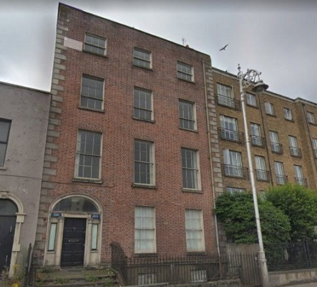
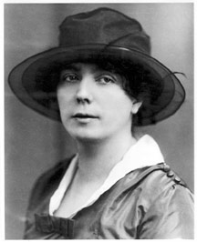
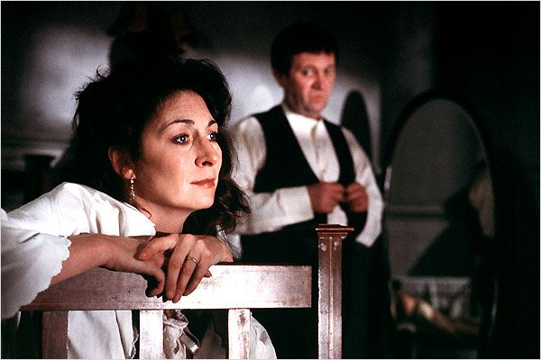
“The Dead” (Dubliners, 1914)
Composed Jan.-Sept. 1907
[...]
Generous tears filled Gabriel’s eyes. He had never felt like that himself towards any woman, but he knew that such a feeling must be love. The tears gathered more thickly in his eyes and in the partial darkness he imagined he saw the form of a young man standing under a dripping tree. Other forms were near. His soul had approached that region where dwell the vast hosts of the dead. He was conscious of, but could not apprehend, their wayward and flickering existence. His own identity was fading out into a grey impalpable world: the solid world itself, which these dead had one time reared and lived in, was dissolving and dwindling.
A few light taps upon the pane made him turn to the window. It had begun to snow again. He watched sleepily the flakes, silver and dark, falling obliquely against the lamplight. The time had come for him to set out on his journey westward. Yes, the newspapers were right: snow was general all over Ireland. It was falling on every part of the dark central plain, on the treeless hills, falling softly upon the Bog of Allen and, farther westward, softly falling into the dark mutinous Shannon waves. It was falling, too, upon every part of the lonely churchyard on the hill where Michael Furey lay buried. It lay thickly drifted on the crooked crosses and headstones, on the spears of the little gate, on the barren thorns. His soul swooned slowly as he heard the snow falling faintly through the universe and faintly falling, like the descent of their last end, upon all the living and the dead. [END]
Joyce visited the the house at 15 Usher’s Island when his aunts lived there in 1904 – probably for an Epiphany party and set “The Dead” there in 1907. The story was filmed there by John Ford in 1987.

Slide 16
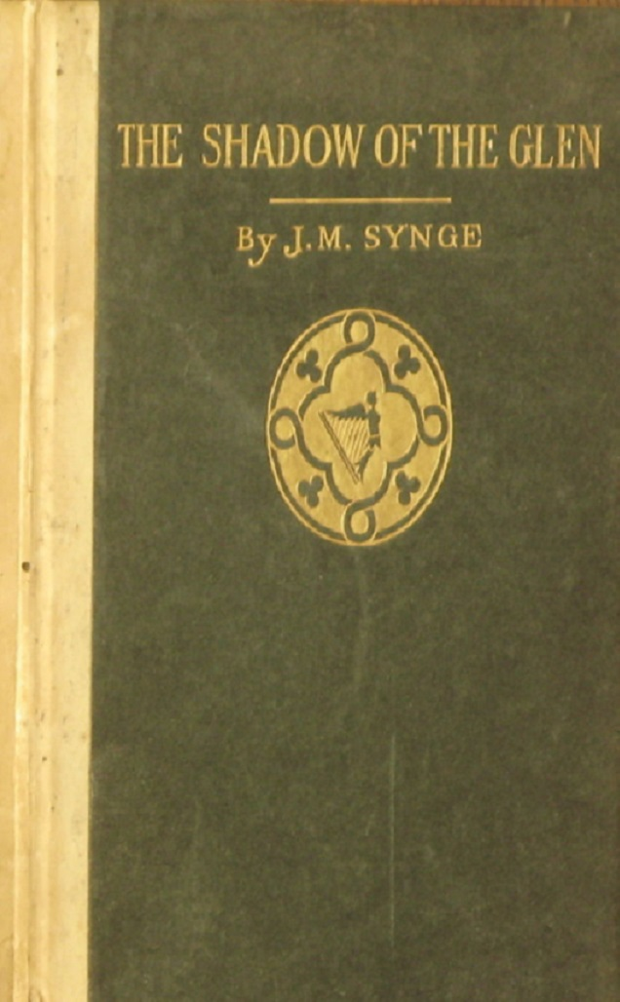
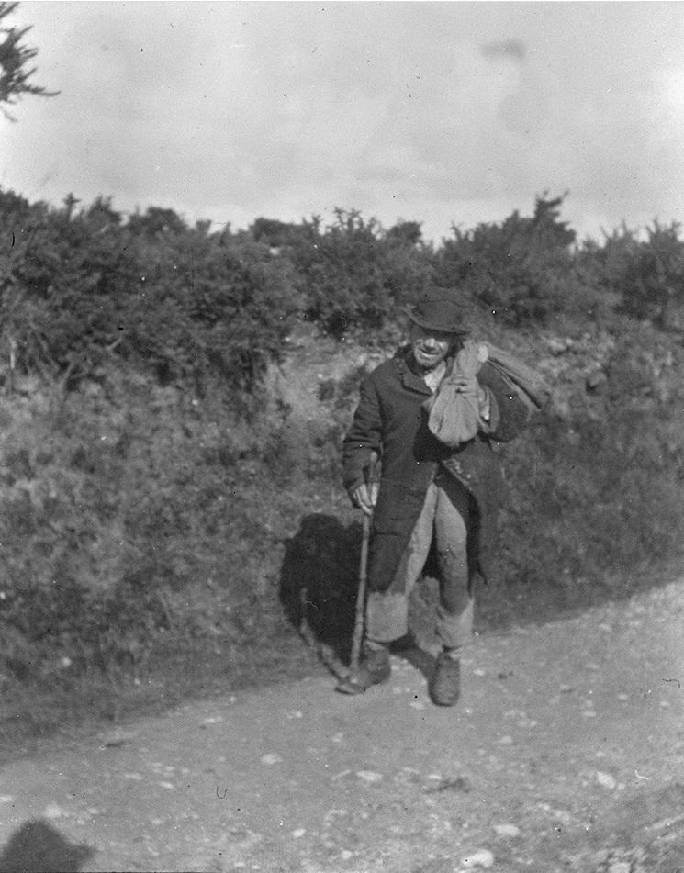
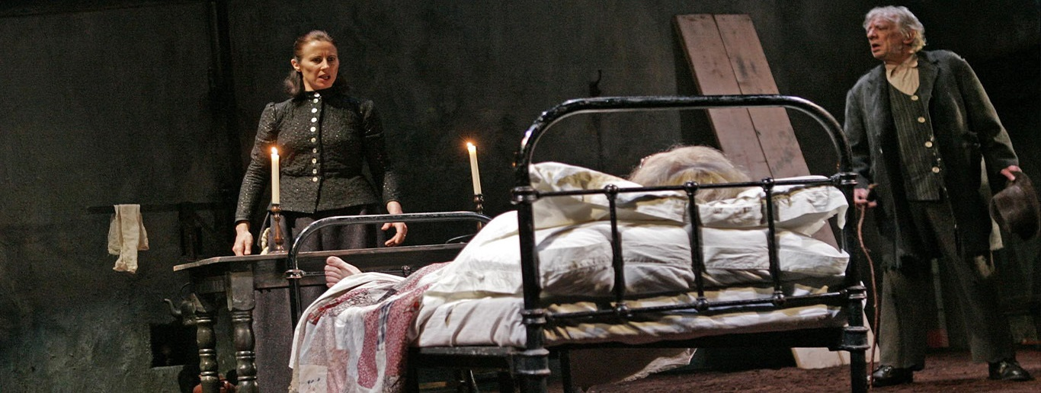
Stanislaus Joyce on The Shadow of the Glen (Dublin, 3 Oct. 1904)
‘The play is a very good comedy and, with another play also by Synge, is the best thing the Irish National Theatre Society has produced. The position may be somewhat unusual, is unusual in as much as it is interesting, but the characters are Irish all of them—the woman, the young farmer, the old man, and the tramp; the humour is Irish and the treatment quite original.’ (The Dublin Diary of Stanislaus Joyce, ed. George Harris Healey, London: Faber 1962, pp.74-75; quoted in Ann Saddlemyer, op. cit., 1982, p.198.)
Synge’s photo of a Wicklow tramp
Druid Production of Shadow of the Glen [1904] (2016)

Slide 17
“A batlike soul”: Davin’s story
Often, as he sat in Davin’s rooms in Grantham Street, wondering at his friend’s wellmade boots that flanked the wall pair by pair and repeating for his friend’s simple ear the verses and cadences of others which were the veils of his own longing and dejection, the rude Firbolg mind of his listener had drawn his mind towards it and flung it back again, drawing it by a quiet inbred courtesy of attention or by a quaint turn of old English speech or by the force of its delight in rude bodily skill - for Davin had sat at the feet of Michael Cusack, the Gael - repelling swiftly and suddenly by a grossness of intelligence or by a bluntness of feeling or by a dull stare of terror in the eyes, the terror of soul of a starving Irish village in which the curfew was still a nightly fear.
Side by side with his memory of the deeds of prowess of his uncle Mat Davin, the athlete, the young peasant worshipped the sorrowful legend of Ireland. The gossip of his fellowstudents which strove to render the flat life of the college significant at any cost loved to think of him as a young fenian. His nurse had taught him Irish and shaped his rude imagination by the broken lights of Irish myth. He stood towards the myth upon which no individual mind had ever drawn out a line of beauty and to its unwieldy tales that divided against themselves as they moved down the cycles in the same attitude as towards the Roman catholic religion, the attitude of a dullwitted loyal serf. Whatsoever of thought or of feeling came to him from England or by way of English culture his mind stood armed against in obedience to a password; and of the world that lay beyond England he knew only the foreign legion of France in which he spoke of serving.
[...]
I started to walk and on I went and it was coming on night when I got into the Ballyhoura hills, that’s better than ten miles from Kilmallock and there’s a long lonely road after that. You wouldn’t see the sign of a christian house along the road or hear a sound. It was pitch dark almost. Once or twice I stopped by the way under a bush to redden my pipe and only for the dew was thick I’d have stretched out there and slept. At last, after a bend of the road, I spied a little cottage with a light in the window. I went up and knocked at the door. A voice asked who was there and I answered I was over at the match in Buttevant and was walking back and that I’d be thankful for a glass of water. After a while a young woman opened the door and brought me out a big mug of milk. She was half undressed as if she was going to bed when I knocked and she had her hair hanging and I thought by her figure and by something in the look of her eyes that she must be carrying a child. She kept me in talk a long while at the door, and I thought it strange because her breast and her shoulders were bare. She asked me was I tired and would I like to stop the night there. She said she was all alone in the house and that her husband had gone that morning to Queenstown with his sister to see her off. And all the time she was talking, Stevie, she had her eyes fixed on my face and she stood so close to me I could hear her breathing. When I handed her back the mug at last she took my hand to draw me in over the threshold and said: ‘Come in and stay the night here. You’ve no call to be frightened. There’s no one in it but ourselves ...’ I didn’t go in, Stevie. I thanked her and went on my way again, all in a fever. At the first bend of the road I looked back and she was standing at the door.
The last words of Davin’s story sang in his memory and the figure of the woman in the story stood forth reflected in other figures of the peasant women whom he had seen standing in the doorways at Clane as the college cars drove by, as a type of her race and of his own, a batlike soul waking to the [186] consciousness of itself in darkness and secrecy and loneliness and, through the eyes and voice and gesture of a woman without guile, calling the stranger to her bed. (A Portrait of the Artist as a Young Man [1944] (London: Jonathan Cape 1968), pp.184-87.)

Slide 18
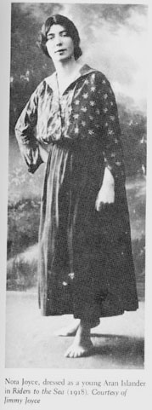
Riders to the Sea – the Zurich Production of 1918
Synge’s death in March 1909 marked the end of any possible personal contact yet Joyce returned to Synge again when he directed Riders for the English Players in Zurich in August 1918—touring to Lausanne. The production was apparently undertaken in a spirit of homage to the playwright whose work he had come to esteem, including the very play he had reviled in manuscript and which he probably saw on stage at its first production in Dublin on 25th February 1904. (He could have chosen The Shadow of the Glen and it is interesting to consider why not.) In the Zurich production, the role of Cathleen, one of the daughters the Aran woman who loses her sons to the sea, was played by Joyce’s partner Nora Barnacle (later Mrs Joyce), thus enabling him to tell the Ulster novelist Forrest Reid that Synge’s text had been ‘spoken with a genuine brogue’ since Nora came from Galway and hence was ‘born within sight of Aran’. Ellmann records that he asked the other actors to imitate Nora as having the right accent but he also lavished praise on the playwright, then ten years dead, calling him a ‘tragic poet’ in the Programme Note to a play which he had previously dismissed as a ‘dwarf tragedy’ in an oblique comment in his review of Lady Gregory’s Poets and Dreamers (1902)—the final clou. Joyce’s new attachment to the piece appears to have more than a little to do with a growing affinity with Nora’s place of birth which also happened to be adjacent to the Joyce Country thus round the circle in a genealogical sense. That affinity is most poignantly mirrored in the emotional transactions between Gabriel and Gretta in “The Dead”, those characters being obvious counterparts of Joyce and Nora in real life in some respects if not in all. [Extract from above titled lecture at ABEI 2021.]
Note: The role of Cathleen was played by Synge’s fiancée Molly Allgood in the first production.

Slide 19
Joyce’s view of Synge and ‘Synge-song’
Arthur Power, in Conversations with James Joyce (1974): ‘Joyce knew him when he was living in rue d’Assas and found him very difficult to get on with. ‘He was so excitable, Joyce told me.’ Of Riders to the Sea: ‘I do not care for it [...] for I think that he wrote a kind of fabricated language as unreal as his characters were unreal. Also in my experience the peasants of Ireland are a very different people from what he made them to be, a hard, crafty and matter-of-fact lot, and I never heard any of them using the language which Synge puts into their mouths. [...]. Those characters only exist on the Abbey stage. But take a man like Ibsen - there is a fine playwright for you. He wrote serious plays about the problems that concern our generation.’ (Power, op. cit., London: Millington Ltd. 1974, pp.33-34.)
  Note that Power holds a contrary opinion and cites remarks from an Irish peasant that strikes him as ‘pure Synge’. (Selected Letters, ed. Richard Ellmann, Faber 1975 pp.140-43.)
Stanislaus Joyce, Triestine Book of Days (5 May 1907)
‘Jim found something in Synge’s mind akin to his own. The heroics and heroic poetry, that the Irish clique might delight in, had no more significance for Synge than for him. The Playboy, with it talk of cleaning people down to their breeches belt, was a study in heroics, just as “Grace’ was a study in Theology, “Two Gallants’ in gallantry, or “Ivy Day in the Committee Room’ in politics, but he thought Synge’s art more original than his own.’ (Quoted in Eric Bulson, Introduction to James Joyce, Cambridge 2006, p.26.)
Herbert Gorman, James Joyce (Bodley Head 1941): Joyce described Synge as ‘a dark tramper of a man’ (p.101; quoted in Anne Gallagher, ‘Tramps, Tinkers and Beggars in the Plays of J. M. Synge’, UUC UG Diss., 2010.)

Slide 20
Joyce on ‘peasant’ drama v. cosmopolitan culture in A Portrait of the Artist ...
April 14. John Alphonsus Mulrennan has just returned from the west of Ireland. [...] He told us he met an old man there in a mountain cabin. Old man had red eyes and short pipe. Old man spoke Irish. Mulrennan spoke Irish. Then old man and Mulrennan spoke English. Mulrennan spoke to him about universe and stars. Old man sat, listened, smoked, spat. Then said:
— Ah, there must be terrible queer creatures at the latter and of the world.
I fear him. I fear his redrimmed horny eyes. It is with him I must struggle all through this night till day come, till he or I lie dead, gripping him by the sinewy throat till.
Till what? Till he yield to me? No. I mean no harm.
[...]
April 16. Away! Away!
The spell of arms and voices: the white arms of roads, their promise of close embraces and the black arms of tall ships that stand against the moon, their tale of distant nations. They are held out to say: We are alone - come. And the voices say with them: We are your kinsmen. And the air is thick with their company as they call to me, their kinsman, making ready to go, shaking the wings of their exultant and terrible youth.
April 26. Mother is putting my new secondhand clothes in order. She prays now, she says, that I may learn in my own life and away from home and friends what the heart is and what it feels. Amen. So be it. Welcome, O life, I go to encounter for the millionth time the reality of experience and to forge in the smithy of my soul the uncreated conscience of my race.
April 27. Old father, old artificer, stand me now and ever in good stead.
p.257; End

Slide 21

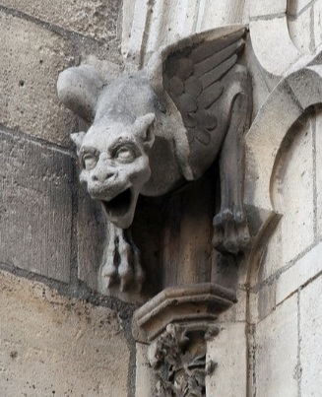
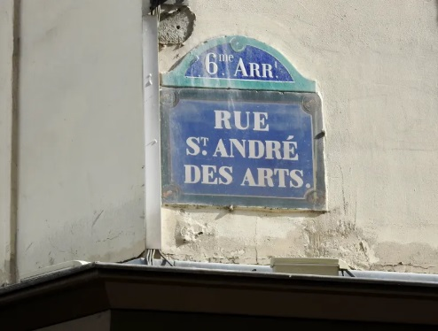
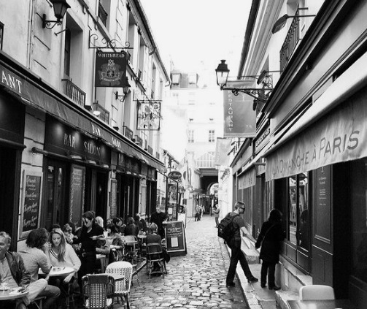
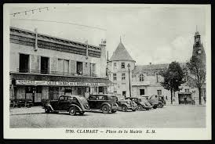
The Synge epiphany in March 1903
‘Harsh gargoyle face that warred against me over our mess of hash of lights in rue Saint-André-des-Arts. In words of words for words, palabras. Oisin with Patrick. Faunman he met in Clamart woods, brandishing a winebottle, C’est vendredi saint! Murthering Irish. His image, wandering, he met. I mine. I met a fool i’ the forest’
Ulysses [1922] (Bodley Head 1960), p.256.
Notes: ‘Gargoyle’, Synge’s physiognomy and the gargoyles of Notre Dame, also on Île de France; ‘lights’ are organ food (e.g. lungs); rue St. André, Arr. 6º - where JMS took JAJ to eat cheaply; palabras, Sp. ‘words’ (cognate with the English palaver); ‘Faunman’, connotes Dionysian creatures in Greek mythology; Oisin, the knight of the Fianna who meets St. Patrick in Acallamh na Senorach and in Yeats’s redaction as Wanderings of Usheen (1889); vendredi saint – It’s holy Wednesday – Holy Week and a therefore a holiday; Clamart – a township nr. Paris where Parisians picnic (Synge thought it very bourgeois to join them); ‘Murthering’ – Hiberno-English for ‘murdering’ and a reference to the Anglo-Irish dread of native Irishmen (of whom Joyce is one); ‘wandering’ – again Yeats but also Synge’s known mode of existence (otherwise ‘tramper’); I met a fool i’ the forest’ Jacques in (Shakespeare’s As You Like it – he continues, ‘“No, sir,” he said, “don’t call me a fool until heaven has sent me my fortune .”’ ( Act. 2, sc. 7). The implication seems to be that both of them are looking for livelihoods and each is in fact on a foolish quest. Joyce says in a letter to Stanislaus of March 1903 that Synge can’t make his way in Paris ‘either’ – implying that both of them are beaten by the local economics. [BS]

Slide 22
Synge’s critics and his defenders
Francis Bickley, J. M. Synge and the Irish Dramatic Movement (London: Constable; NY: Houghton Mifflin 1912), Chap. I - “Synge’s Career”: Synge’s entry of the theatrical world of Dublin was by no means triumphant. Even the superb Riders to the Sea failed at first to attract audiences. The Shadow of the Glen, his first play to be acted (October 1903), was received not with indifference, but with hostility. Satires on Irish life, such as Mr. George Moore’s The Bending of the Bough, could be tolerated, but satire on the Irish peasantry - the time-honoured idol of sentimentalists was in no wise to be borne. The favourable comparison between Irish women and the women of England or Scotland in the matter of chastity, was a trump card in the hands of the Nationalists. Here was a writer who seemed to call it in question; such a thing was impolitic, if no worse. It goes without saying that Synge had no desire to lower his compatriots in the eyes of the world. But if he had only found one unchaste woman in the four provinces and had thought her the right stuff for drama he would have dramatised her; or if he had found none, he would have invented one had his purpose required it. For he was an artist before he was a Nationalist, and a very long way before. The political question did not exist for the dramatist. But to the majority of Irishmen art still means a political pamphlet. (p.15-16.)
St John Ervine, Impressions of My Elders (NY: Macmillan 1922): Synge could not compel himself to climb on to platforms or make extravagant boasts. He may have had the desire to make boasts, but he had not the courage to do so. An excellent comrade for an individual on a country road, he was so nervous in the presence of an audience of more than six people that he was in danger of physical sickness, and he may be said to have died of sheer inability to assert himself.* Had it not been that Yeats was by to do Synge’s boasting for him, the world might never have heard of that singular man of twisted talent. [...] Synge was [...] was the sick man in literature, and he had the sick man’s interest in cruelty and harshness and violent temperaments. He had the weak man’s envy of strength and the sick man’s liability to mistake violence for strength. [...] He shot his bolt when he wrote The [sic without Only] Playboy of the Western World, the chief value of which lay in the fact that it ripped up the smugness of the Irish people, than whom there are no other people in the world so pleased with themselves on such slender grounds, and taught them the much-needed lesson that they are very much like the rest of God’s creatures. [...]

Slide 23
John Millington Synge (1860-1909)
James Augustine Joyce (1882-1941)
Born of upper-class landowning Protestant family.
Born middle-class property Catholics.
Lost his father to smallpox young; grew up under influence of Plymouth Brethern.
Lost his mother at 21; his father was chronically impecunious, garrulous and ‘a praiser of his own past’.
Educated private schools, Royal Irish Acad. of Music and Trinity College Dublin (Hebrew, Irish).
Educated Jesuit schools and University College, Dublin (run by Jesuits); qualified in French, Italian and English.
Converted to evolutionism and became atheist; did not seek employment; studied music in Germany (tramped in Italy, according to Yeats)
Embraced literature as vocation at early age; developed strongly anti-clerical and atheist views but retained interest in Catholic theology and liturgy.
Settled in Paris in 1895; studied ethnology and languages at Sorbonne and attended the lectures of Henri d’Arbois Jubainville; wrote diaries in Irish and an early autobiography.
Wrote autobiographical novel as ‘Stephen Daedalus’; proselytised for Ibsen’s realism; contested the nativist (peasant-folklore) tendency of the Irish Lit. Revival.
Travelled in Wicklow, Connemara and Aran learning vernacular Irish; wrote articles on his experience for Manchester Guardian issued Aran Islands, an ethnographical study.
Travelled to Paris on graduation (‘Welcome, O life!” and embarked on life-long exile interrupted by a stay in Dublin, 1903-1904, during which he met Nora Barnacle.
Returned to Ireland to participate in Dramatic Movement; wrote his famous plays; fell in love with Sarah Allgood (35 his junior); died of Hodgkins disease.
Wrote Ulysses in Trieste and Zurich; moved to Paris; became figurehead of literary modernism in English.

Slide 24
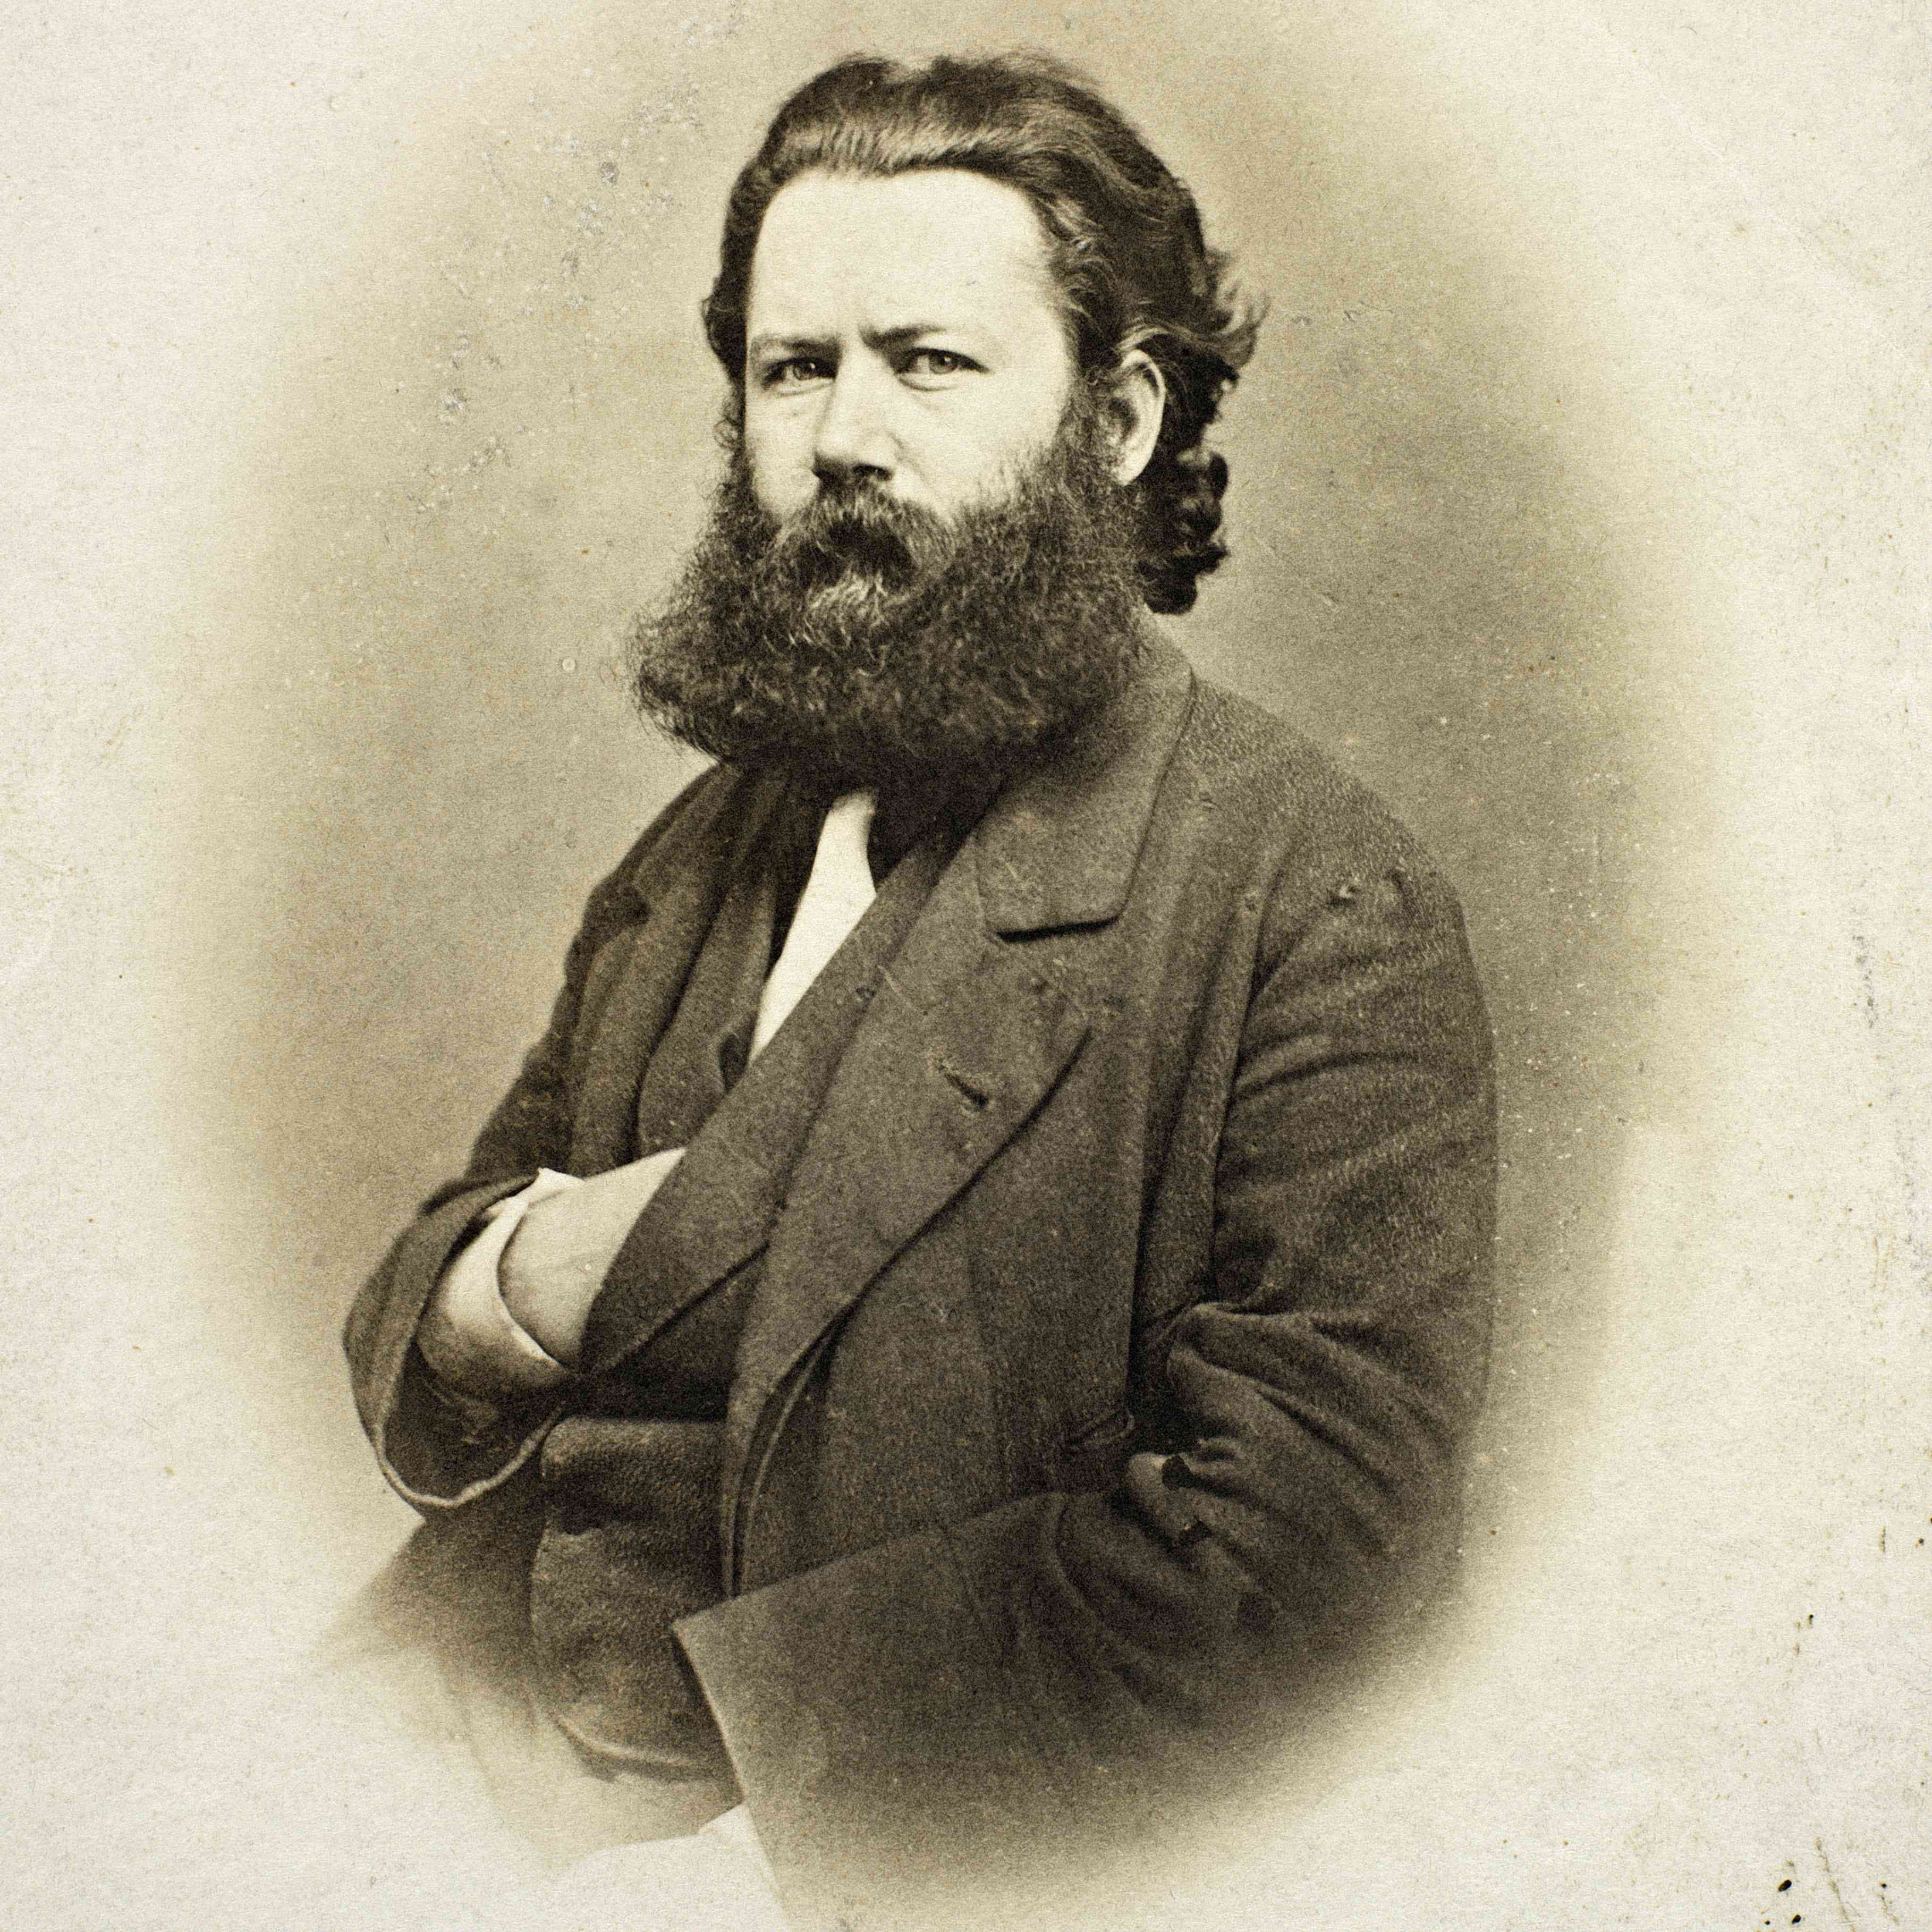
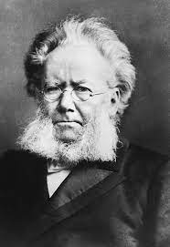
“Inward heroism”: Joyce’s homage to Henrik Ibsen (March 1901)
[Joyce’s English draft:] ‘What shall I say more? I have sounded your name defiantly through the college where it was either unknown or known faintly and darkly. I have claimed for you your rightful place in the history of the drama. I have shown what, as it seemed to me, was your highest excellence - your lofty impersonal power. Your minor claims - your satire, your technique and orchestral harmony - these, too, I advanced. Do not think me a hero-worshipper - I am not so. And when I spoke of you in debating societies and so forth, I enforced attention by no futile ranting. / But we always keep the dearest things to ourselves. I did not tell them what bound me closest to you. I did not say how what I could discern dimly of your life was my pride to see, how your battles inspired me - not the obvious material battles but those that were fought and won behind your forehead, how your wilful resolution to wrest the secret from life me heart and how in your absolute indifference to public canons of art, friends and shibboleths you walked in the light of your inward heroism. And this is what I write to you of now. Your work on earth draws to a close and you are near the silence. It is growing dark for you. Many write of such things, but they do not know. You have only opened the way - though you have gone as far as you could upon it - to the end of “John Gabriel Borkman” and its spiritual truth - for your last play stands, I take it, apart. But I am sure that higher and holier enlightenment lies - onward.’ (Selected Letters, ed. Richard Ellmann, London: Faber & Faber 1975, p.7.)

