Slide 1
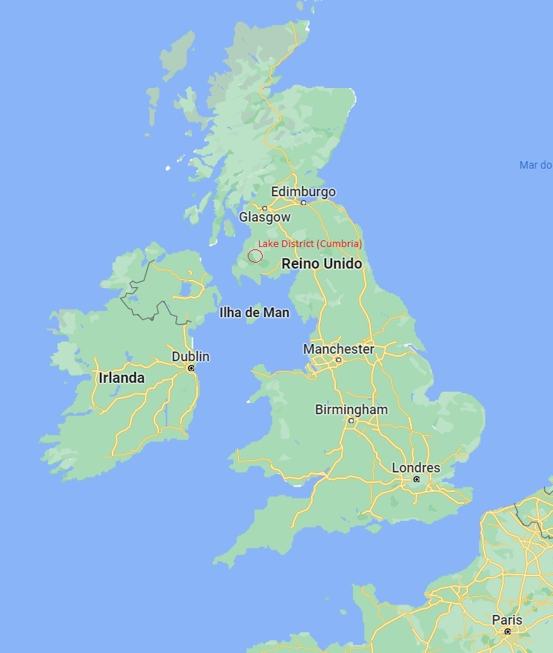
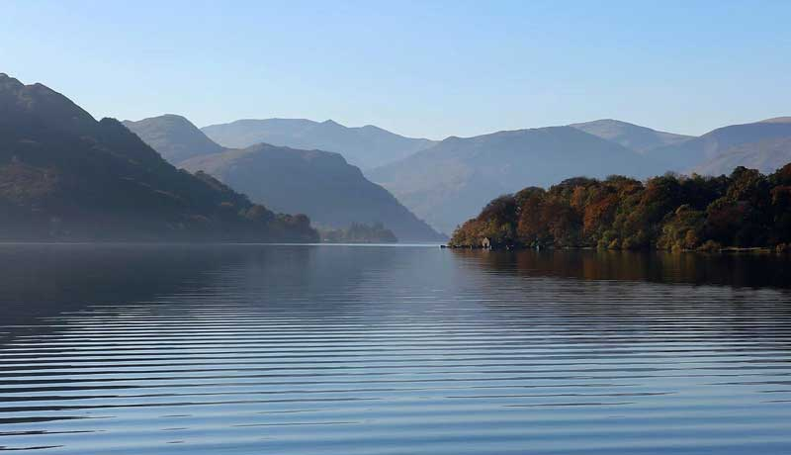
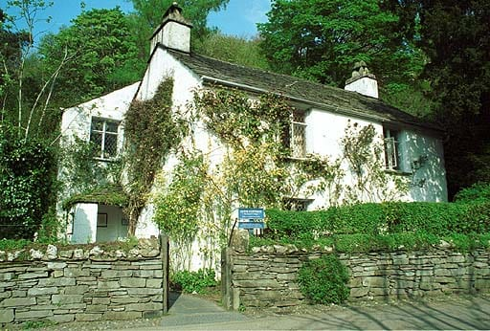

The Lake District (Cumbria)
It seems certain that Wordworth´s child-hood in one of the most scenic parts of Britain – virtually on the Celtic Fringe – enabled the formation of an intense personal sensibility which a childhood nearer to the metropolitan centres such as London would not and could not have done.

Slide 2
William Wordsworth (1770-1850)
In 1791, during the height of the French Revolution, Wordsworth visited Paris and fathered a child with a young woman called Annette Vallon. He supported mother and child in later life, but in 1802 he married a childhood friend called Mary Hutchinson—immediately following a short visit to Paris to settle matters with his little family there. In [1805 he wrote in a poem about that period of his life: “Bliss was it in that dawn to be alive, But to be young was very heaven!” Implicit, in those verses was the idea that the Utopia dream had died as the French Revolution advanced along a bloody road to Madame La Guillotine. Besides, England had been at war with France since 1797.
Wordsworth’s formal education was that of a upper-middle class young man of the period, being the son of a lawyer who served as estates manager to a English lord (Earl of Lonsdale). He proceeded from Hawkshead Grammar School in the Lake District of Cumberland (or Cumbria) where he spent an enchanted boyhood to Cambridge University where he took an Arts degree and engaged in the intellectual fervour of the day.
As a child he had been encouraged to read and memorise English poetry by his father, the owner of a fine library. In another way, however, his childhood was exceptional for a child of his class. Growing up among scenes of unusual natural beauty, he developed an intense feeling of love for, and awe of, Nature. This was to become the source of an almost mystical power in his poetry, effectively replacing Christianity as the chief spiritual principal in his thinking and that of many whom he influenced or with whom shared his romantic feelings through verse and prose. Simultaneously (and perhaps relatedly) he acquired a keen sense of the dignity and interest of the ordinary people whom he encountered in that lovely landscape and whose attitudes towards life—chiefly their resilience and their good-natured acceptance of fate—inspired many of his poems.
In this way, William Wordsworth became the first major English poet to turn the experience of the common people into the subject-matter of published poetry, albeit writing in the persona of an unnamed poetic “I” who is clearly an educated man (very like the poet himself). Indeed, in many of the poems the speaker’s voice is precisely a sensitive gentleman footloose in the countryside who extracts portions of human wisdom from encounters with such characters as “The Mad Mother” and “The Leech-gatherer” whose speech is given in quotation marks. It is not entirely certain that their little speeches fulfil the promise made in his Preface to the second edition of the Lyrical Ballads (1798; 2nd edn. 1800, enl. 1802) where he writes that the proper language of poetry is “real language of men in a state of vivid feeling” but it is clear that in his simpler lyrics his own speech is of that kind.
Thus arose the idea that the “truth” of the individual imagination in a state of “powerful feeling” was the real stuff of poetry – and idea that long governed Romantic poetry and defined its ethical goals. Yet Wordsworth also wrote philosophical poems in a Miltonic vein, with a philosophical vocabular employed in long reflective lines and this is very Much part of his legacy and in some ways his finest writing. (Thus it is, for instance, in “Lines Written a Few Miles Above Tintern Abbey” and in his “Ode on Intimations of Immortality”, as we shall see.
Wordsworth was not the first to adopt simple rural people as the topic of his poems. That honour belongs to the Reverend Thomas Gray in his “Elegy in a Country Churchyard”. He was, however, the first to devise a poetic language in which that subject matter could be met in its natural form rather than filtered through the Augustan system of antithetical phrases and classical allusions. William Wordsworth was, indeed, the first English Romantic poet and the founder of that resilient literary movement.
Recommended website: https://www.poets.org/poet/william-wordsworth

Slide 3
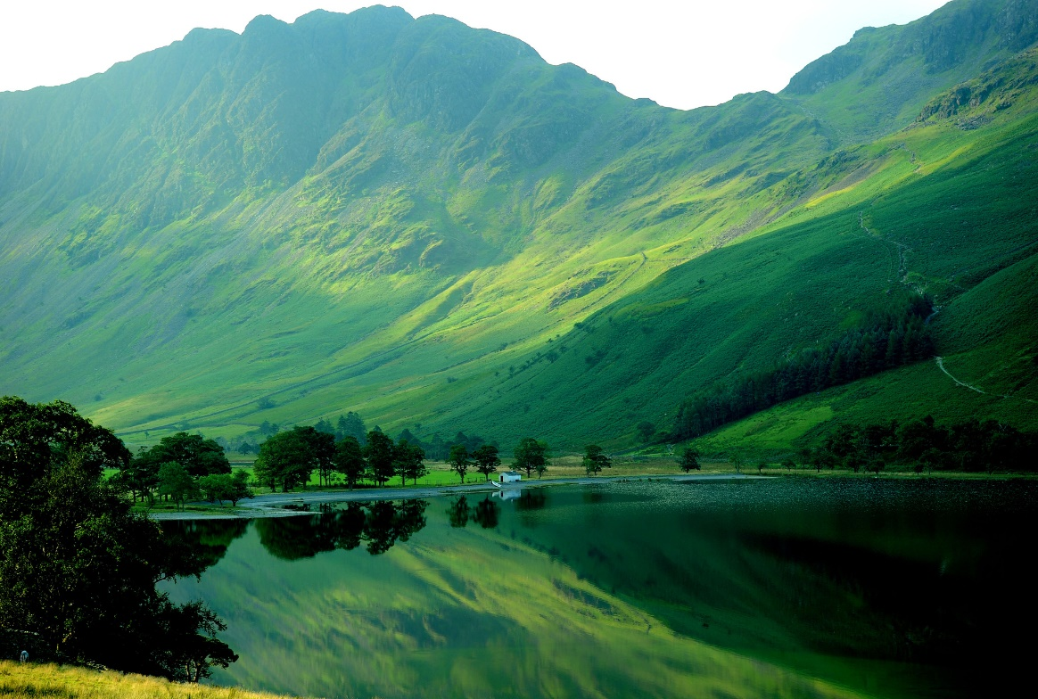
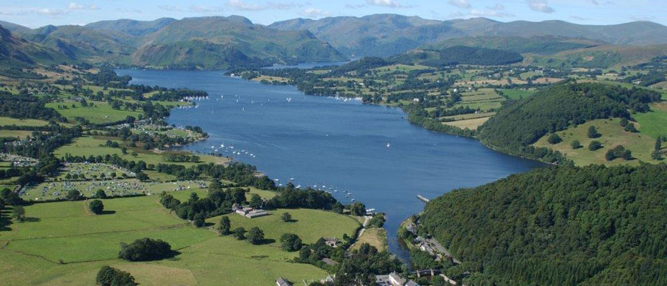
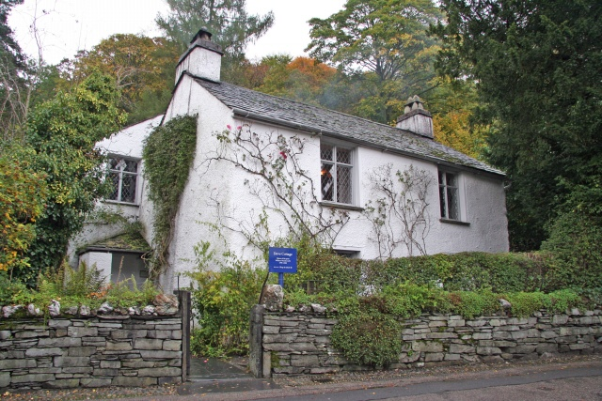
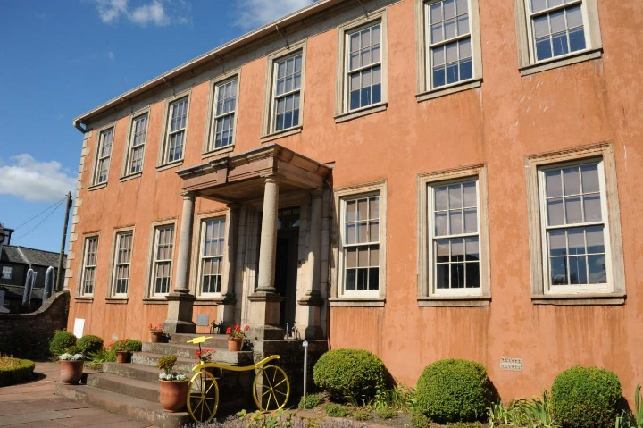
A Scenic Childhood
The Lake District (Cumberland), in the Northwest of England. Ullswater Lake [above] is regarded as the most beautiful part of the region but the uplands have an inexhaustible attraction for English people and especially hill-walkers.
Wordsworth’s actual birthplace is not a humble cottage. He enjoyed all the privileges of a wealthy man’s son—the house they lived in being the property of the land owner whom his father served as a lawyer. In his 29th year, Wordsworth received a considerable sum of money due to his deceased father from Lord Lonsdale and this enabed him to marry and dedicate himself to life as a poet.
Dove Cottage - the little cottage where Wordsworth and Coleridge wrote and compiled the Lyrical Ballads (1800) is still preserved and much-visited today.

Slide 4
William Wordsworth [cont.]
On his return from France Wordsworth settled in Dove Cottage in the Lake District parish of Grasmere with his sister Dorothy in 1799, soon sharing that home with his new friend Samuel Taylor Coleridge (1772-1834). Dorothy, who was the diarist of the group. There he and Coleridge wrote and compiled the poems to be found in Lyrical Ballads and Some Other Poems (1800) in collaboration with a lesser contributor called Robert Southey – who had a long and successful literary career and remained a faithful supporter of Coleridge in that brilliant man’s troubled life.
The Lyrical Ballads immediately soon came to be regarded as the herald of a new way of feeling and the cornerstone of the English Romantic Movement. In a second edition of 1800, Wordsworth added a Preface of his own setting out the principles of the new movement as he understood them, while disowning any pretension to a full-blown theory of poetry which he holds to be too large a subject. Later on, in his Biographia Literaria, Coleridge would write critically of the ideology of the Preface but it remains the major manifesto of the Romantic turn at that crucial moment of English literary history.
In his 1800 Preface, Wordsworth identified the source of lyric poetry as “the spontaneous overflow of powerful feelings [which] takes its origin from emotion recollected in tranquility”, and further declared that the idiom of such poetry should be “the real language of real men in a state of vivid sensation” when fitted to a “metrical arrangement”. – since poetry without metre is merely prose . The last is a point which modern poets would, of course contest though the victory of Free Verse is by no means assured. In fact, Wordsworth himself expressed a strong dislike for “poetic diction” and cast doubt on the usual distinction between poetry and prose - since both, in a philological perspective, employ metaphors and cadences (or rhythm) to convey the living feelings of their authors. If that goal is reached, is it not poetry whatever its form. (Wordsworth once wrote of the moment when the sensitive writer becomes “a living soul” under the influence of natural scenes.)
It is clear from his manner of discussing Poetry, however, that Wordsworth regarded poetry as the higher and more essential form of thought than Science or Philosophy since it is and that he believed it was the poet imagination rather than the rationative intelligence which conceives those ideas in which a scientist gives permanent form to his theoretical discoveries about the laws of the physical world. According to Wordsworth, all the greatest thinkers are thus poets and – by implication – all the greatest poets are philosophers. More tellingly, perhaps, he believed that the primary form of creative thought arises from a certain sympathy with Nature rather than from a cold, objective examination of the world, and that in this sense Nature prompts us to understand her in the degree to which we allow her to enter our minds and hearts.
It is clear this is, at least in part, a pantheistic notion of the world which attributes a spirit to Nature which we can share through contact with the scenes in which she declares herself. (It is impossible to miss the point that this is in some sense a new religion with a female deity embodied by Nature.) Those scenes are, of course, part of the landscape in which the poet’s mind was formed. Wordsworth felt it necessary to document this process in a long autobiographical poem to be called “The Excursion” of which only “The Prelude” survives. (For long this was called his “Poem to Coleridge”.)
In it he deals with the episodes of his childhood, especially those on the Cumberland lakes, when he experiences the overwhelm awe of the natural world. Wordsworth made a considerable mark on the critical thinking of his age in formulating the criteria by which the value of an original poet should be judged. Being aware that he himself could not be considered a serious poet by Augustan standards of the last century, he proposed the idea that a great poet is one who creates the taste by means of which he himself comes to be appreciated and judged. There is little doubt that Wordsworth achieved exactly that and, in so doing, shifted the way the English thought of poetry for all time and influenced others far beyond its shores.
Recommended website: https://www.poetryfoundation.org/poems-and-poets/poets/detail/william-wordsworth

Slide 5
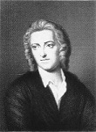
Thomas Gray’s “Elegy Written in a Country Churchyard” (1750).
The curfew tolls the knell of parting day,
The lowing herd wind slowly o’er the lea,
The plowman homeward plods his weary way,
And leaves the world to darkness and to me.
[...]
Beneath those rugged elms, that yew-tree’s shade,
Where heaves the turf in many a mould’ring heap,
Each in his narrow cell for ever laid,
The rude forefathers of the hamlet sleep.
For them no more the blazing hearth shall burn,
Or busy housewife ply her evening care:
No children run to lisp their sire’s return,
Or climb his knees the envied kiss to share.
[...]
Let not Ambition mock their useful toil,
Their homely joys, and destiny obscure;
Nor Grandeur hear with a disdainful smile
The short and simple annals of the poor.
[...]
Full many a gem of purest ray serene,
The dark unfathom’d caves of ocean bear:
Full many a flow’r is born to blush unseen,
And waste its sweetness on the desert air.
Some village-Hampden, that with dauntless breast
The little tyrant of his fields withstood;
Some mute inglorious Milton here may rest,
Some Cromwell guiltless of his country’s blood.
[Here Gray remembers a particular friend]
“There at the foot of yonder nodding beech
That wreathes its old fantastic roots so high,
His listless length at noontide would he stretch,
And pore upon the brook that babbles by.
“Hard by yon wood, now smiling as in scorn,
Mutt’ring his wayward fancies he would rove,
Now drooping, woeful wan, like one forlorn,
Or craz’d with care, or cross’d in hopeless love.
[...]
“One morn I miss’d him on the custom’d hill,
Along the heath and near his fav’rite tree;
Another came; nor yet beside the rill,
Nor up the lawn, nor at the wood was he;
“The next with dirges due in sad array
Slow thro’ the church-way path we saw him borne.
Approach and read (for thou canst read) the lay,
Grav’d on the stone beneath yon aged thorn.”
Here rests his head upon the lap of Earth
A youth to Fortune and to Fame unknown.
Fair Science frown’d not on his humble birth,
And Melancholy mark’d him for her own.
Large was his bounty, and his soul sincere,
Heav’n did a recompense as largely send:
He gave to Mis’ry all he had, a tear,
He gain’d from Heav’n (’twas all he wish’d) a friend.
No farther seek his merits to disclose,
Or draw his frailties from their dread abode,
(There they alike in trembling hope repose)
The bosom of his Father and his God.
The bosom of his Father and his God.
Comment: “The Elegy was most probably begun soon after the death of Gray’s school-friend West, some reminiscences of whom remain in the conclusion of the poem. West had been Gray’s dearest friend and confidant, and like himself a melancholy and hypochondriac young man. The “youth to fortune and to fame unknown” of the closing epitaph might be either West or Gray himself, and is, indeed, by a process familiar to dream-analysts, a sort of fusion of the two.”
—Graham Hough, The Great Romantics, 1962.)
[ My emphasis – BS ]

Slide 6
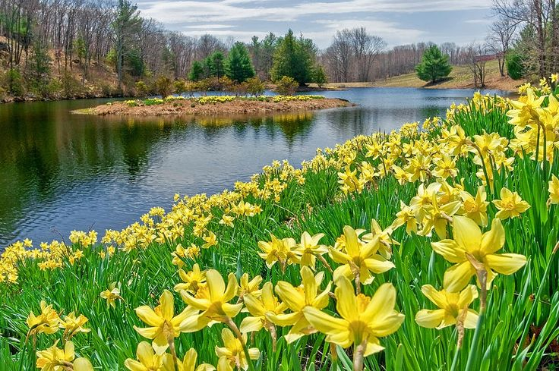
“The Daffodils” by William Wordsworth
I wandered lonely as a cloud
That floats on high o’er vales and hills,
When all at once I saw a crowd,
A host, of golden daffodils;
Beside the lake, beneath the trees,
Fluttering and dancing in the breeze.
Continuous as the stars that shine
And twinkle on the milky way,
They stretched in never-ending line
Along the margin of a bay:
Ten thousand saw I at a glance,
Tossing their heads in sprightly dance.
The waves beside them danced; but they
Out-did the sparkling waves in glee:
A poet could not but be gay,
In such a jocund company:
I gazed—and gazed—but little thought
What wealth the show to me had brought:
For oft, when on my couch I lie
In vacant or in pensive mood,
They flash upon that inward eye
Which is the bliss of solitude;
And then my heart with pleasure fills,
And dances with the daffodils.
Dorothy Wordsworth left an account in her diary of the occasion which inspired her brother’s poem about daffodils (“I wandered lonely as a cloud ..”. The first thing to be noticed is that the poet was not along (‘lonely’) when he saw this extraordinary display of ephemeral beauty by a lakeside. In fact, the poem enacts his leading idea that the subject of a poem is always emotion “recollected in tranquillity” in as much as the poet claims that the sight of the “dancing” flowers soothes his mind in later times whenever he remembers them. He might also say that they propose themselves to his mind as the subject of a poem and that he has only the put his idea to “fitting metre” and to alter any details in the narrative needed to create the right impression – in this case the impression of poetic solitude which so often defines the romantic poet.
  When we were in the woods beyond Gowbarrow park we saw a few daffodils close to the water side, we fancied that the lake had floated the seed ashore & that the little colony had so sprung up – But as we went along there were more & yet more & at last under the boughs of the trees, we saw that there was a long belt of them along the shore, about the breadth of a country turnpike road. I never saw daffodils so beautiful they grew among the mossy stones about and about them, some rested their heads upon these stones as on a pillow for weariness & the rest tossed and reeled and danced & seemed as if they verily laughed with the wind that blew upon them over the Lake, they looked so gay ever dancing ever changing. This wind blew directly over the lake to them. There was here & there a little knot & a few stragglers a few yards higher up but they were so few as not to disturb the simplicity & unity & life of that one busy highway – We rested again & again. The Bays were stormy & we heard the waves at different distances & in the middle of the water like the Sea. (Dorothy Wordsworth, The Grasmere Journal Thursday, 15 April 1802.)

Slide 7
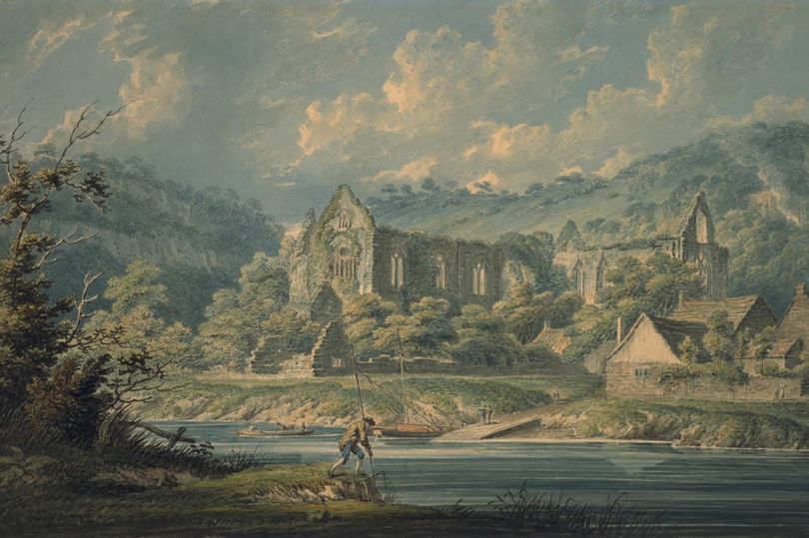
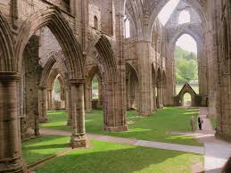

Tintern Abbey on the River Wye (Monmouthshire)
Tintern Abbey was already famed as a scenic spot when Wordsworth wrote his poem as the painting of 1794 by Edward Days demon-strates. The Abbey became a ruin when the monasteries were closed by Henry VIII at the English Reformation in 1534. As a ruin, it served well to represent the idea of “natural piety” which Wordsworth invokes in his poem bearing its name.
As a ruin, the Abbey served well to represent the idea of “natural piety” which Wordsworth invokes in his poem bearing its name.

Slide 8
William Wordsworth, “Lines Composed a Few Miles above Tintern Abbey, On Revisiting
the Banks of the Wye during a Tour. July 13, 1798”.
…]
These beauteous forms,
Through a long absence, have not been to me
As is a landscape to a blind man’s eye:
But oft, in lonely rooms, and ‘mid the din
Of towns and cities, I have owed to them,
In hours of weariness, sensations sweet,
Felt in the blood, and felt along the heart;
And passing even into my purer mind
With tranquil restoration:—feelings too
Of unremembered pleasure: such, perhaps,
As have no slight or trivial influence
On that best portion of a good man’s life,
His little, nameless, unremembered, acts
Of kindness and of love. Nor less, I trust,
To them I may have owed another gift,
Of aspect more sublime; that blessed mood,
In which the burthen of the mystery,
In which the heavy and the weary weight
Of all this unintelligible world,
Is lightened:—that serene and blessed mood,
In which the affections gently lead us on,—
Until, the breath of this corporeal frame
And even the motion of our human blood
Almost suspended, we are laid asleep
In body, and become a living soul:
While with an eye made quiet by the power
Of harmony, and the deep power of joy,
We see into the life of things.
If this
Be but a vain belief, yet, oh! how oft—
In darkness and amid the many shapes
Of joyless daylight; when the fretful stir
Unprofitable, and the fever of the world,
Have hung upon the beatings of my heart—
How oft, in spirit, have I turned to thee,
O sylvan Wye! thou wanderer thro’ the woods,
How often has my spirit turned to thee!
[…]
(1798; pub. 1800)
Q: Tintern Abbey features in the title but not in the poem. Who built the Abbey and why is it a ruin?
Q: Is Wordsworth talking about Nature or Historical decline? (Buildings fall back into Nature.)
Q: How does the Abbey qualify to share in the power of Nature which he describes elsewhere in the same terms?
Q: Is Tintern Abbey romantic – and if so why?
Q: Wordsworth writes: ‘… made quiet by the power of harmony’: what does he mean?
The italicised phrases may help you to identify the make points of the poem’s argument involving the idea that Nature informs our moral life and helps us to understand the meaning of existence when the world—meaning society and business—seems to render it ‘joyless’ and devoid of meaning. (The italics are mine: BS.)

Slide 9
[…T]he babe leaps up on his mother’s arm:—
I hear, I hear, with joy I hear!
—But there’s a tree, of many, one,
A single field which I have look’d upon,
Both of them speak of something that is gone:
The pansy at my feet
Doth the same tale repeat:
Whither is fled the visionary gleam?
Where is it now, the glory and the dream?
[…]
Our birth is but a sleep and a forgetting:
The Soul that rises with us, our life's Star,
Hath had elsewhere its setting,
And cometh from afar:
Not in entire forgetfulness,
And not in utter nakedness,
But trailing clouds of glory do we come
From God, who is our home:
Heaven lies about us in our infancy!
Shades of the prison-house begin to close
Upon the growing Boy,
But he beholds the light, and whence it flows,
He sees it in his joy;
The Youth, who daily farther from the east
Must travel, still is Nature's priest,
And by the vision splendid
Is on his way attended;
At length the Man perceives it die away,
And fade into the light of common day.
[…]
Thou little Child, yet glorious in the might
Of heaven-born freedom on thy being’s height,
Why with such earnest pains dost thou provoke
The years to bring the inevitable yoke,
Thus blindly with thy blessedness at strife?
Full soon thy soul shall have her earthly freight,
And custom lie upon thee with a weight,
Heavy as frost, and deep almost as life!
[…]
Then sing, ye birds, sing, sing a joyous song!
And let the young lambs bound
As to the tabor’s sound!
We in thought will join your throng,
Ye that pipe and ye that play,
Ye that through your hearts to-day
Feel the gladness of the May!
What though the radiance which was once so bright
Be now for ever taken from my sight,
Though nothing can bring back the hour
Of splendour in the grass, of glory in the flower;
We will grieve not, rather find
Strength in what remains behind;
In the primal sympathy
Which having been must ever be;
In the soothing thoughts that spring
Out of human suffering;
In the faith that looks through death,
In years that bring the philosophic mind.
[…]
The innocent brightness of a new-born Day
Is lovely yet;
The clouds that gather round the setting sun
Do take a sober colouring from an eye
That hath kept watch o’er man’s mortality;
Another race hath been, and other palms are won.
Thanks to the human heart by which we live,
Thanks to its tenderness, its joys, and fears,
To me the meanest flower that blows can give
Thoughts that do often lie too deep for tears. [End]
(1802-04; pub. 1807.)
“Ode on Intimations of Immortality from Recollections of Early Childhood”
Wordsworth’s “Ode on Immortality” proposes a theory of the soul and its voyage from birth to death which involves the idea of forever diminishing ability to sense the spiritual aspect of material existence and to receive the messages of Nature which convey and confirm that spiritual dimension.
It is the “glory and the dream” of the boy who can sense the meaning of the “pansy at [his] feet” through immediate perception that informs the belief-system of the grown man. As the poet grows older, the “prison-house” begins to close around him ever more closely reducing his to “see into the life of things” (Tintern Abbey). His reaction is to develop an intellectual faith in Nature during the later years of life which “bring the philosophical mind”.
The imaginative life of the poet is therefore divided into between two modes: the first, a form of immediate perception when he can say, “I hear! I hear!” the voice of Nature, and a second phase in which he can only speak about it as something known and understood in an intellectual sense.
Not surprisingly, his poems are similarily divided into those which chapter the immediate impression of Nature as a spiritual being and those in which he reflects on the question of meaning in purely philosophical terms.
In each different type of poem, a different form of imagery and a different kind of diction can be found – but the object remains the same: to convey to the reader the poets faith in the moral power of Nature. In this sense, Wordsworth’s romanticism is a new religion. And that triggers problems of Christian orthodoxy for the man himself …

Slide 10
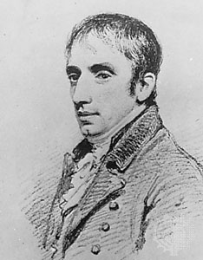
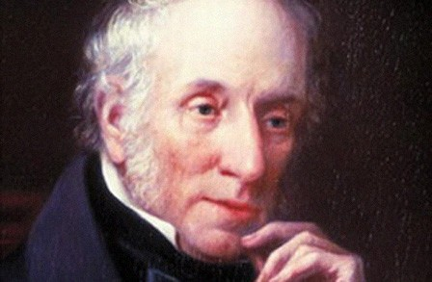
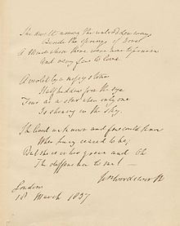
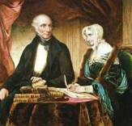
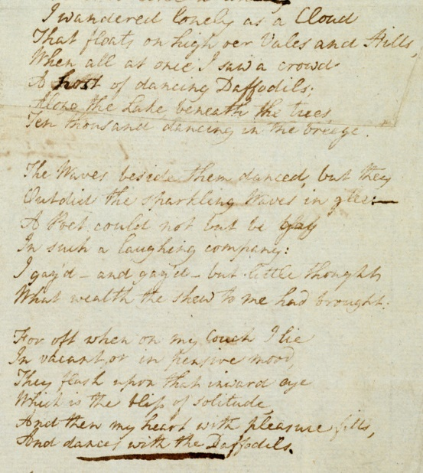
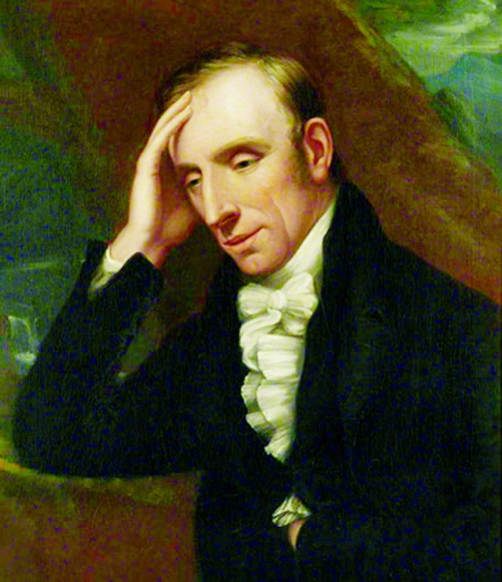
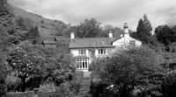
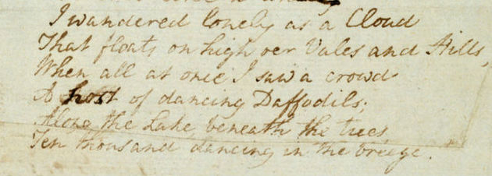
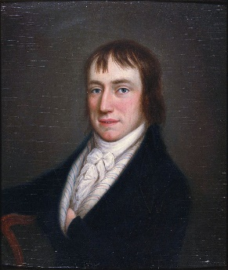
Portraits and Poems
Rydalsmount House where Wordsworth lived with his sister Dorothy from 1813 until his death in 1850.

